Slide 1


Institute of Electrical and Electronics Engineers (IEEE)
Brian Thai
President

Slide 2
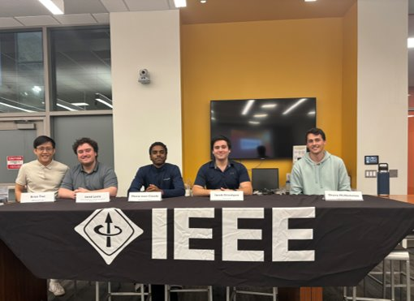
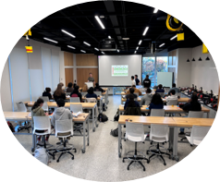
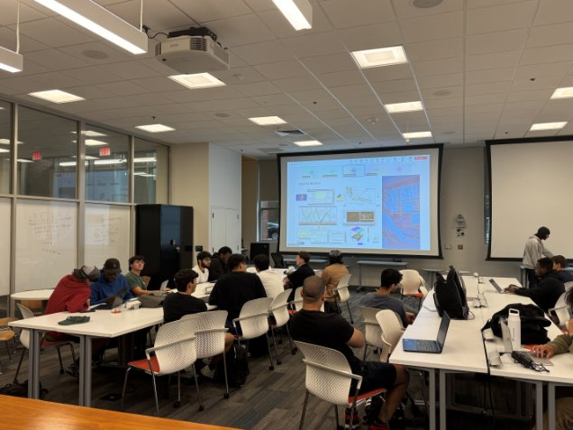
What is Temple IEEE?
Host skill-building workshops like soldering,
Arduino, and GitHub
Provide networking opportunities with various
companies like Lockheed Martin, KBR, and Peco
Prepare students for internship applications and
the interview process
Attend IEEE Regional Student Activities Conference
Plan to have more social events and joint events
with other organizations, both within and outside
of Temple University

Slide 3
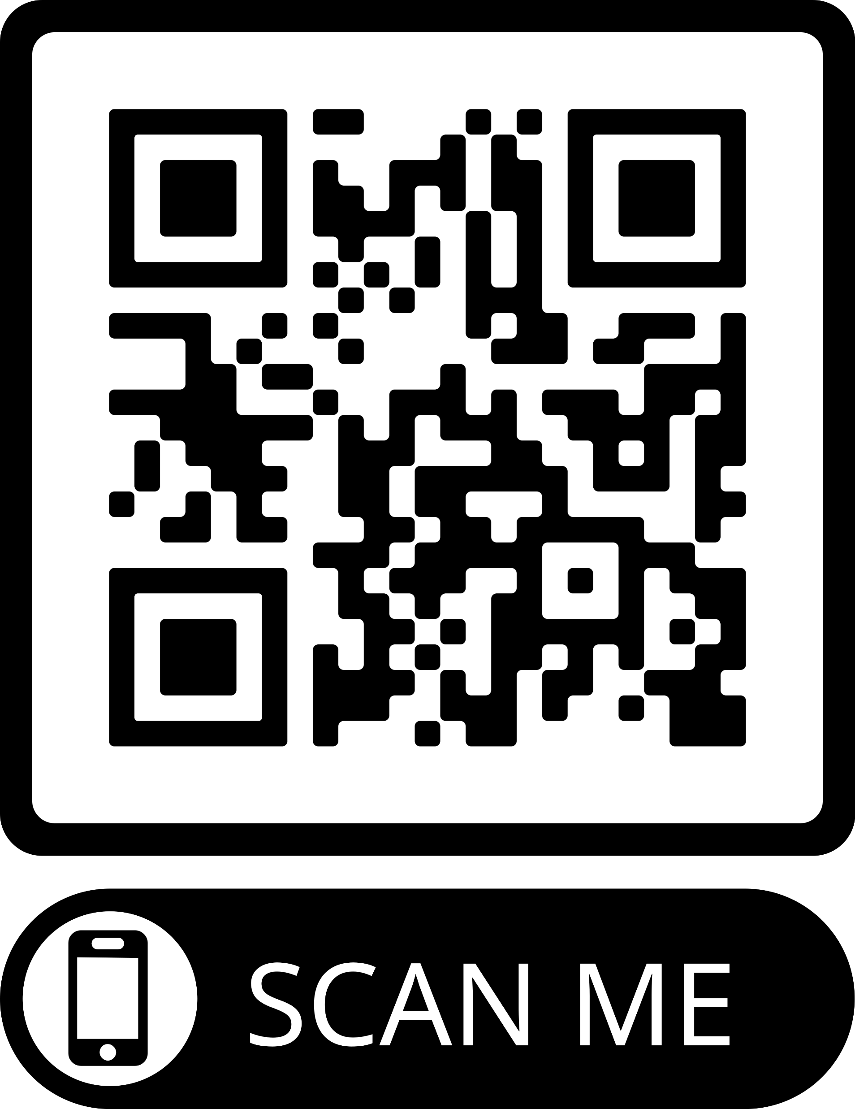
IEEE Membership
Priority Access to Temple IEEE Events, Student Activity Conference
More funding for Temple IEEE events
Global network of over 400,000 peers
Access to IEEE scholarships
Ability to be nominated for various awards for outstanding achievements
Networking opportunities with IEEE members (professionals and students)
Subscriptions to various professional magazines
Ability to be nominated for various honor societies and affinity groups
Continuing education benefits

Slide 4
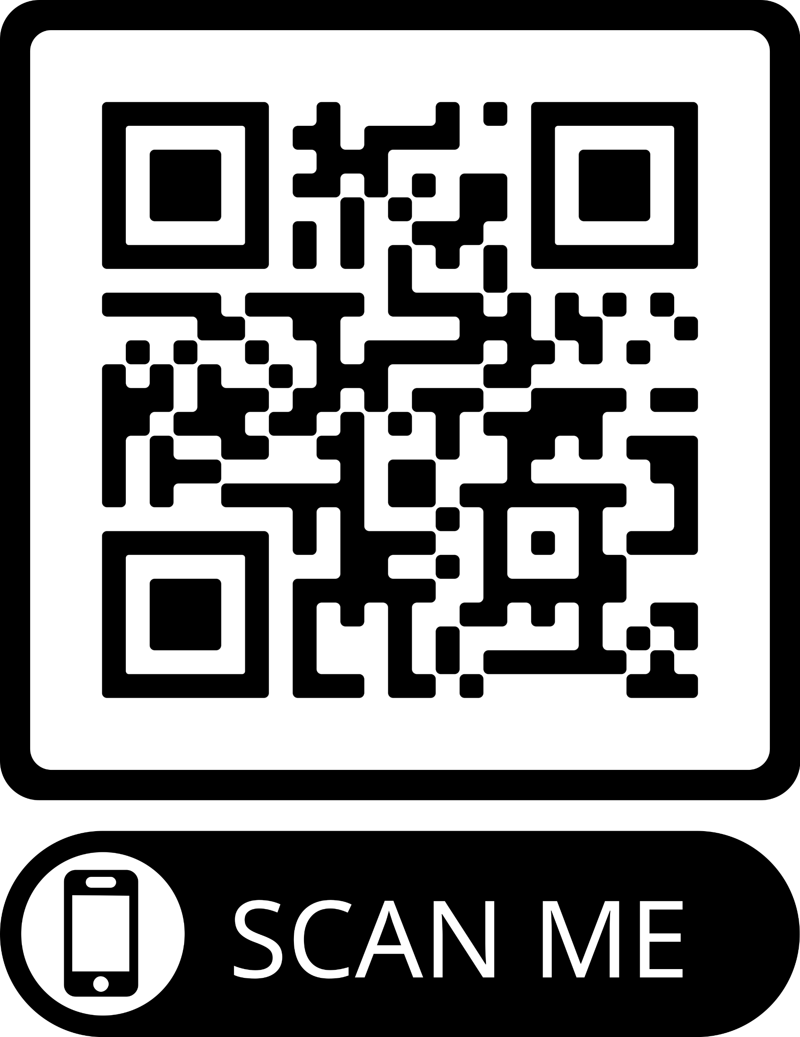
How to Contact Us
Temple IEEE Email: ieee@temple.edu
Temple IEEE Teams: Temple IEEE | General | Microsoft Teams
Temple IEEE Instagram: temple_ieee
My Email: brianh.thai@temple.edu
My Teams: Brian Thai

Slide 5

Questions?

