Slide 1
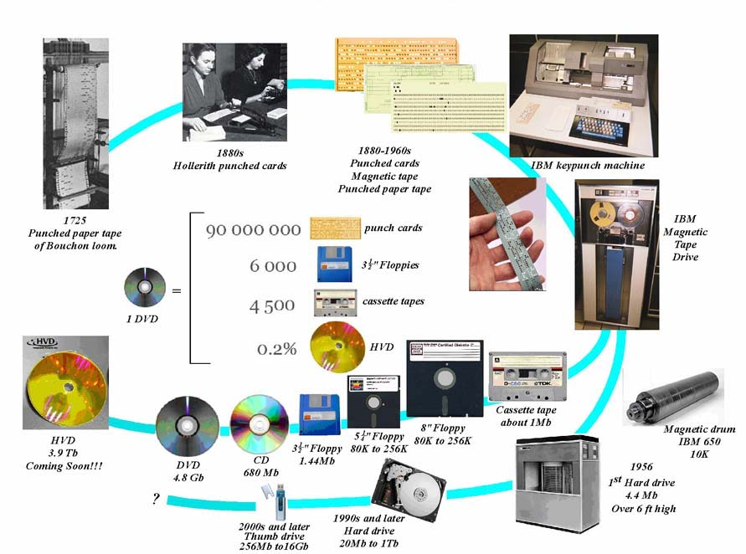
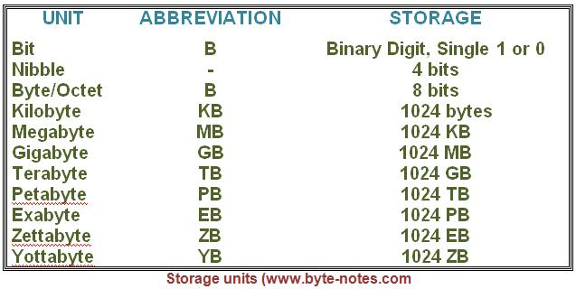
Lecture 12: C – Atomic Types
Topics:
Bytes and Chars
Short and Long Integers
Floats and Doubles
Signed and Unsigned
Bits and Bytes Revisited
Resources:
TP: Atomic Types
Wiki: ASCII
Wiki: Unicode
Wiki: IEEE Floating-Point
Wiki: Binary Coded Decimal
Branah: ASCII Conversion

Slide 2
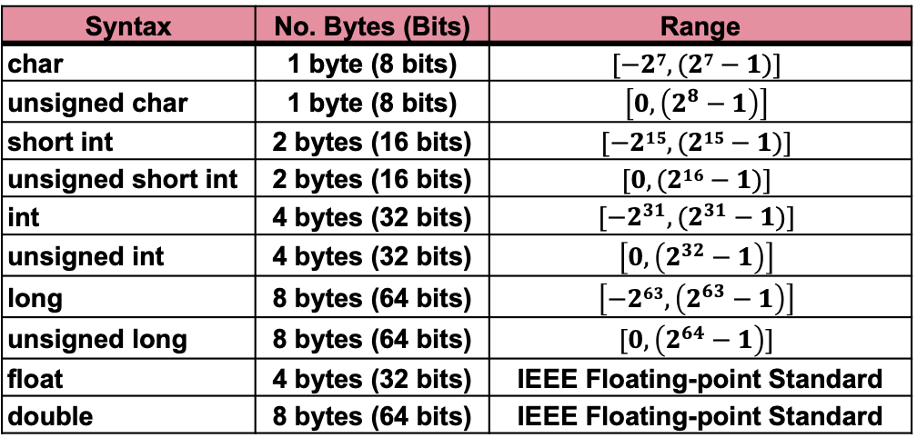
Summary
Atomic Types: used to do basic math.
ASCII: the decimal codes used by characters follow the ASCII standard.
Unicode: some languages require more than 8 bits per character.
Binary Coded Decimal: positive integers use a format where each digit is represented by a fixed number of bits.
Two’s Complement: negative numbers use a two’s complement format.
IEEE Floating-Point Format: a logarithmic representation. They are not exact!
Syntax | No. Bytes (Bits) | Range
char | 1 byte (8 bits) | $$[−27, (27−1)]$$
unsigned char | 1 byte (8 bits) | $$\left[0, \left(2^{8}−1\right)\right]$$
short int | 2 bytes (16 bits) | $$[−215, (215−1)]$$
unsigned short int | 2 bytes (16 bits) | $$[0, (216−1)]$$
int | 4 bytes (32 bits) | $$[−2^{31},(2^{31}−1)]$$
unsigned int | 4 bytes (32 bits) | $$\left[0, \left(2^{32}−1\right)\right]$$
long | 8 bytes (64 bits) | $$\left[−263,\left(2^{63}−1\right)\right]$$
unsigned long | 8 bytes (64 bits) | $$[0,\left(2^{64}−1\right)]$$
float | 4 bytes (32 bits) | IEEE Floating-point Standard
double | 8 bytes (64 bits) | IEEE Floating-point Standard

