Slide 1
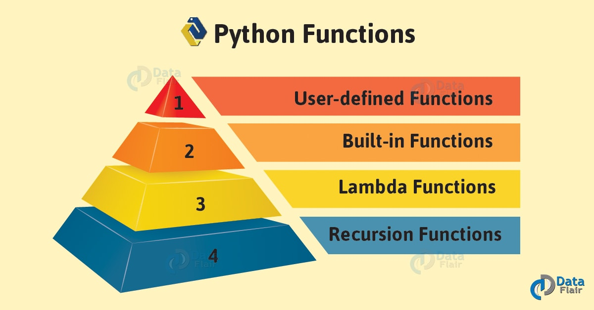
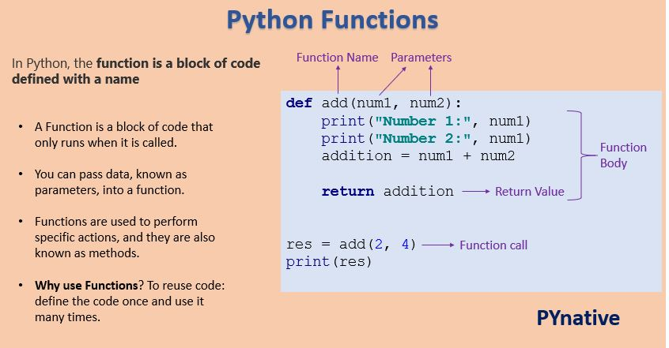
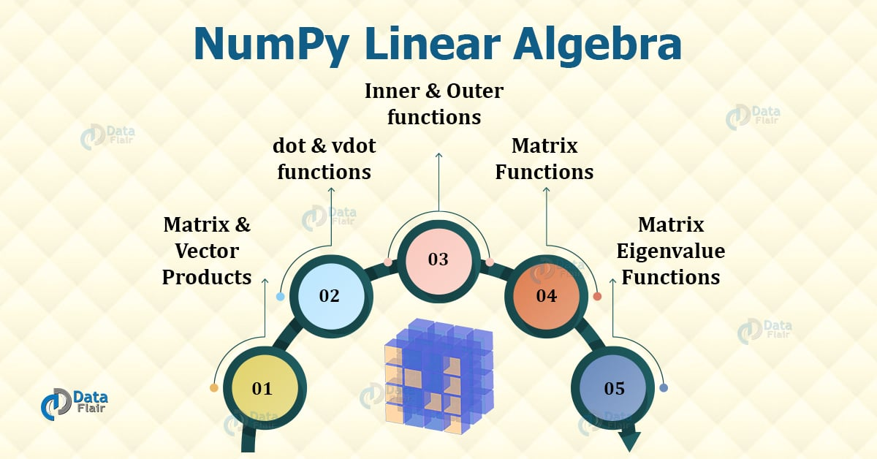
Lecture 07: Python – Functions and Linear Algebra
Topics:
Function Arguments
Function Return Values
Memory Management
Matrices as Lists
Matrices in Numpy
Basic Linear Algebra
Resources:
GeeksForGeeks: Python Functions
GeeksForGeeks: Python Numpy

Slide 2
Summary
Functions – Python functions offer significant flexibility including:
A name/value pair syntax
Optional arguments
Memory management via the garbage collector
Multiple return values
Numpy – the preferred Python library for numeric calculations involving vectors and matrices:
Compact memory footprint for data structures similar to C/C++
Computationally-efficient algorithms
Flexible multi-dimensional data structures
Dynamic memory allocation (vectors and matrices can be resized)
Wide range of mathematical functions available
Compatible with many other packages (e.g., SKlearn)

