Slide 1
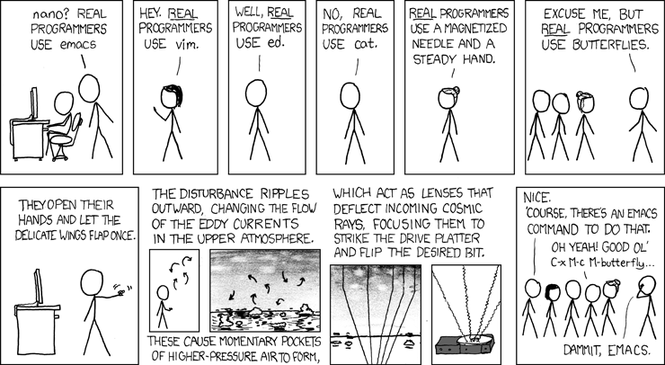
Lecture 03: Linux – Editor MACroS (EMACS)
Topics:
Text Editors (e.g., ed, sed, vi)
Buffers, Screens and Shells
LISP Programming
Macros
Demonstration
Fun Stuff
Resources:
GNU: An extensible customizable editor
LinkedIn: Unix Text Editors
GNU IRC: The Emacs Channel
YouTube: VIM Basics
Wiki: The History of Emacs
Batsov: Emacs Resources

Slide 2
Summary
Smart Text Editors and IDEs: Editors help you develop, format and debug code quickly.
Emacs: Since 1972, emacs has been evolving as one of the first interactive What You See Is What You Get (WYSIWYG) editors. It is one of the longest and most successful software engineering projects.
Linux: Emacs is now distributed as part of the Linux operating system.
Customizable: Everything in emacs can be reprogrammed using LISP code. It can be configured from a set of configuration files (e.g., .emacs).
Screen Management: Emacs lets you split the screen into buffers and easily move text between these buffers.
Macros: A sequence of keystrokes can be recorded and reused as a complex command. We use these to process large amounts of text.
Modes: Emacs has many modes that allow you to do things like edit directory trees, run Unix shells and learn through built-in help.
Cheat Sheets: There are many trifolds, called cheat sheets, that list the most useful commands. Once you learn how to use the built-in help, you don’t need to rely on these.

