Slide 1
LECTURE 41: Jobs, Jobs, Jobs…
Topics:
Guest Speaker
Gaining Programming Experience
Job Interviews
Career Paths
Resources:
What is a software engineer?
Navigating your career path
Stack Overflow Survey

Slide 2
Summary
A software engineer applies mathematical analysis and the principles of computer science in order to design and develop computer software.
The software engineering market (2024) has definitely slowed due to the economy, but it is still as competitive as it has ever been because there is a shortage of experienced senior developers who can quickly bring applications to market.
Electrical and computer engineers often work on embedded systems.
Embedded Software Engineering is the process of controlling various devices and machines that are different from traditional computers, using software engineering. Integrating software engineering with non-computer devices leads to the formation of embedded systems. A typical embedded system requires a wide range of programming tools, microprocessors and operating systems. Embedded software engineering, performed by embedded software engineers, needs to be tailored to the needs of the hardware that it has to control and run on.
Updating your skills regularly is critical in a rapidly evolving field like software engineering. Look for jobs that provide training or allow you to develop code using leading-edge tools.
DevOps, Full-Stack Development and Real-time Operating Systems are just a few of the many opportunities that are in great demand.

Slide 3
Jobs! Jobs! Jobs!
Speaker: Shivali Srivastava

Slide 4
How could I get a job interview?
How could I survive a job interview?
How can I get my foot in the door?

Slide 5
What does our college education gives us?
Diploma
Ability to learn
What does our college education gives to our employer?
Specialized technical knowledge and expertise necessary for the job
Seen as a signal of a candidate’s ability to learn complex information and develop critical thinking skills
Demonstrates commitment to completing tasks and having relevant soft skills like communication and teamwork
This Photo by Unknown Author is licensed under CC BY

Slide 6
Apply online?
Immediately rejected
AI doesn’t work in candidate’s favor most of the times. Resulting frequently in auto reject.

Slide 7
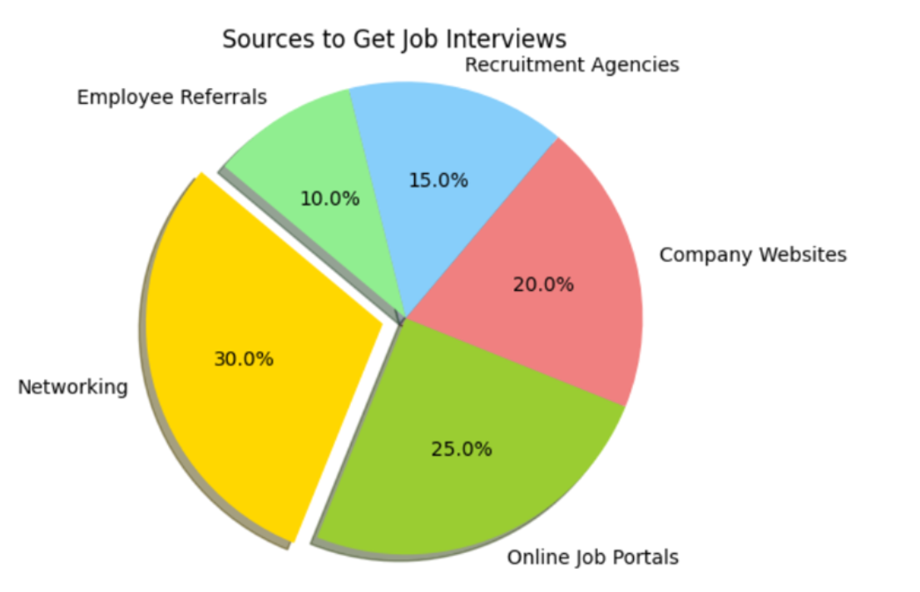
Networking is often the most effective way to secure job interviews, followed by online job portals and company websites.

Slide 8
Online Job Portals:
Indeed: Known for its extensive job listings and user-friendly interface, Indeed is one of the most popular job search engines
LinkedIn: Great for networking and job searching, LinkedIn allows you to connect with professionals and apply for jobs directly through the platform
Glassdoor: Offers job listings along with company reviews, salary information, and insights into company culture
ZipRecruiter: Uses AI technology to match job seekers with employers and offers a mobile app for job searching on the go
CareerBuilder: Provides a wide range of job listings and tools to help you create a strong resume and apply for jobs quickly
SimplyHired: Aggregates job listings from various sources and offers tools like a resume builder and salary estimator
Monster: One of the oldest job search engines, Monster offers job listings, career advice, and resume services

Slide 9
What Many Companies are Actually Doing?
DEI conferences: GHC, SHPE and NSBE
Returning interns: Returning interns are given priorities as they have good feedback from their respective teams where they previously interned.
Employee Referrals: Resumes submitted through employee referrals get priority.

Slide 10
DEI Organizations, Conferences/Conventions and Career Fairs
Using DEI organizations like GHC (Grace Hopper Celebration), SHPE (Society of Hispanic Professional Engineers), and NSBE (National Society of Black Engineers) can significantly enhance your chances of securing internship positions.
These organizations, their conferences/conventions and career fairs are valuable for STEM students seeking internships and career opportunities.

Slide 11
Grace Hopper Celebration (GHC) Career Fair:
The GHC career fair is part of the Grace Hopper Celebration, the largest annual gathering of women in technology, organized by AnitaB.org. It focuses on empowering women and other underrepresented groups in tech.
Key Features:
- Top-Tier Employers: Tech giants like Google, Microsoft, Amazon, Qualcomm, Meta and startups recruit for internships and full-time roles.
- Diversity Focus: GHC promotes gender diversity in technology, offering opportunities specifically for women and non-binary individuals.
- On-the-Spot Interviews: Many recruiters conduct interviews and extend offers during the event.
Why Attend:
- Access to high-impact networking opportunities and career development workshops.
- Scholarships for students to attend for free, covering travel and lodging.
When & Where:
- Held annually in the fall (e.g., 2024: October in Orlando, FL).

Slide 12
NSBE Career Fair The NSBE Annual Convention is a gathering for Black engineers, offering one of the largest STEM career fairs in the U.S. It’s hosted by the National Society of Black Engineers, which aims to increase the number of Black professionals in STEM.
Key Features:
- Diverse Employer Base: Includes Fortune 500 companies, startups, and government agencies (e.g., NASA, Lockheed Martin).
- Workshops & Panels: Sessions focus on professional development, leadership, and technical skills.
- Community Focus: A supportive environment designed to empower Black engineers.
Why Attend:
- Employers are actively seeking diverse talent.
- Great for building connections with industry leaders and finding mentors.
When & Where:
- Held annually in the spring (e.g., 2024: Atlanta, GA).

Slide 13
SHPE Career Fair
The SHPE National Convention is the largest event for Hispanic STEM professionals and students. It’s organized by the Society of Hispanic Professional Engineers, which supports Hispanics in engineering, computing, and related fields.
Key Features:
- Employer Variety: Includes tech companies, energy firms, aerospace organizations, and government agencies.
- Scholarship Opportunities: SHPE offers scholarships directly linked to its convention.
- On-the-Spot Offers: Similar to NSBE and GHC, many recruiters hire directly during the fair.
Why Attend:
- Focus on Hispanic representation in STEM.
- Networking opportunities with Hispanic leaders in technology and engineering.
When & Where:
- Held annually in the fall (e.g., 2024: Denver, CO).

Slide 14
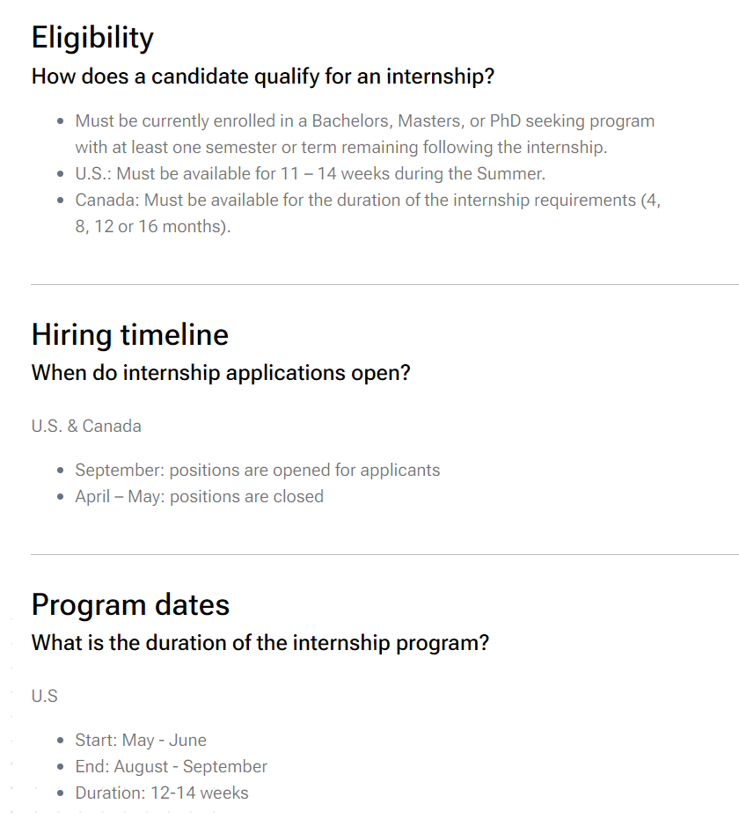
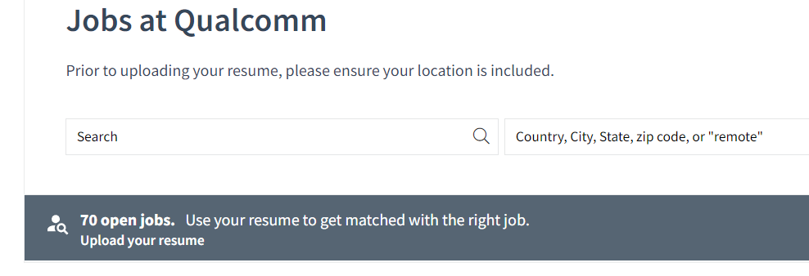
Qualcomm Internship
https://careers.qualcomm.com/careers?seniority=Intern&pid=446701742978&domain=qualcomm.com&sort_by=relevance&triggerGoButton=false
Resumes submitted through referrals get priority.

Slide 15
The Qualcomm Student Accelerator (QSA) is a program designed to connect top students with Qualcomm professionals through a series of workshops, networking events, and career development sessions. Here are some key details:
Key Features:
Workshops: Focus on technical skills, professional development, and industry insights.
Networking: Opportunities to connect with Qualcomm employees and other students.
Career Advice: Sessions on interview preparation and career planning.
Exposure to Qualcomm: Learn about Qualcomm's technologies, projects, and career opportunities.
Timing and Location:
When: The event typically takes place over a weekend in the fall, often in September or October
Where: The event is usually held at Qualcomm's headquarters in San Diego, California
This program is an excellent opportunity for students to enhance their skills, gain valuable insights, and connect with industry professionals.

Slide 16
Few Examples of Most Valuable Skills in Today’s Job Market –
AI, ML
Data Science and Analytics
Data Engineering
Data Visualization
Cybersecurity
Cloud Computing

