Slide 1
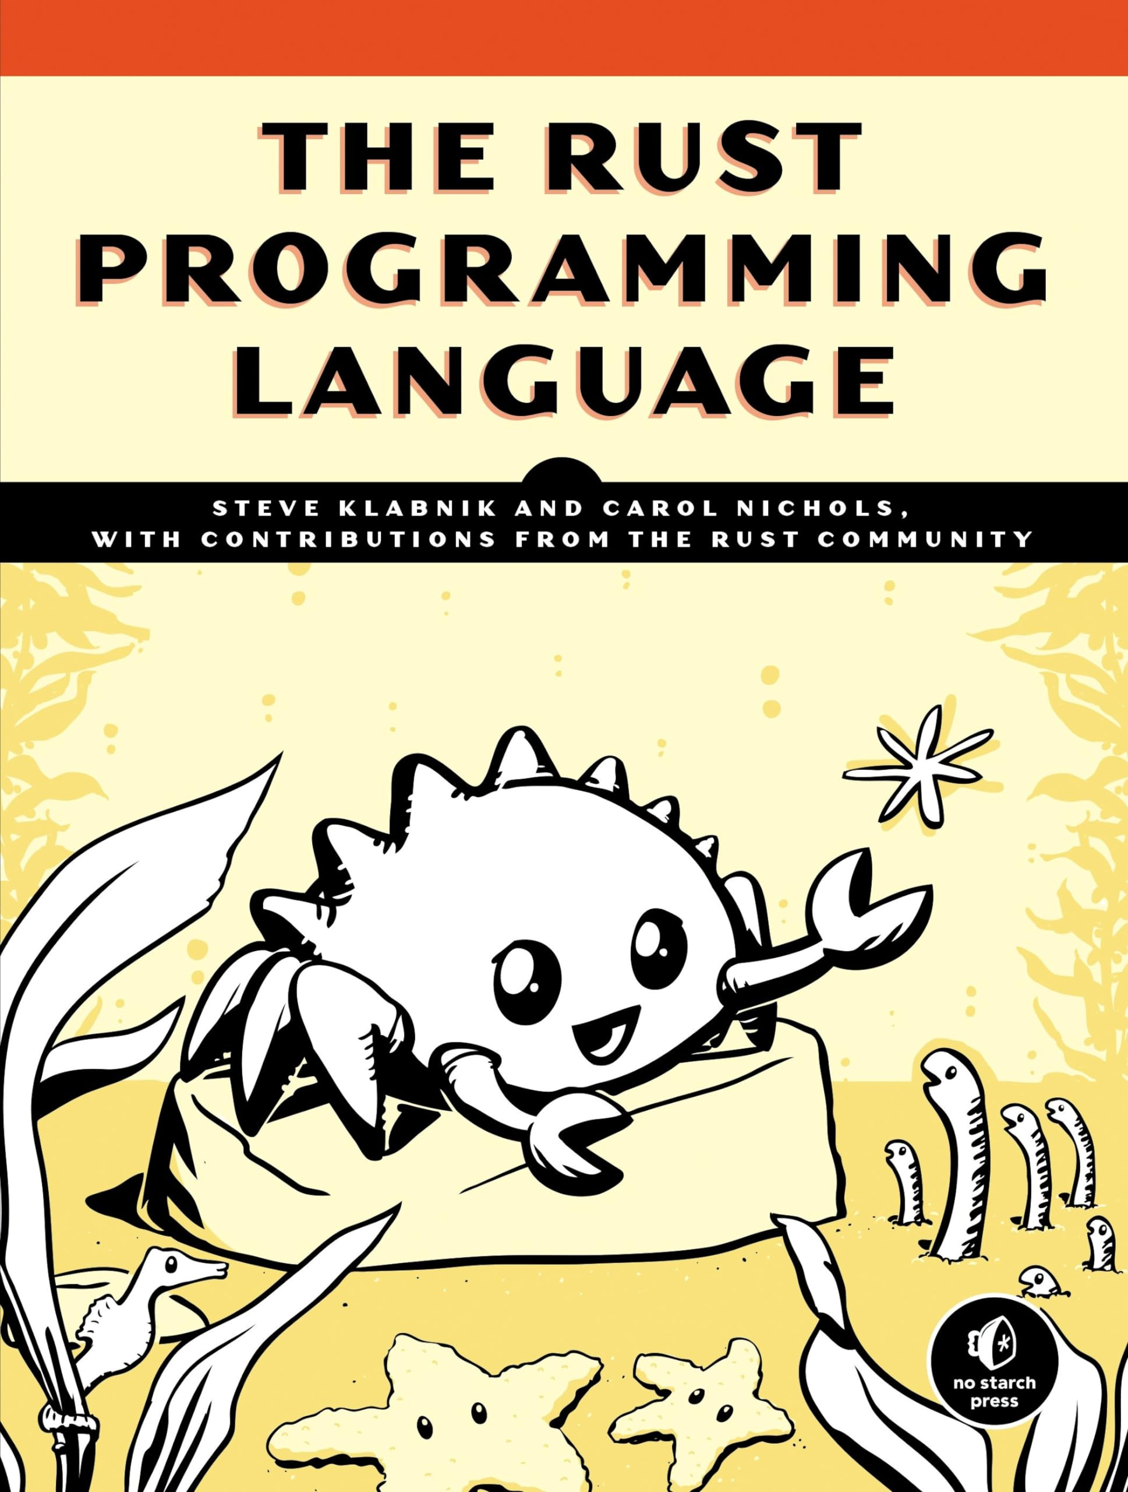
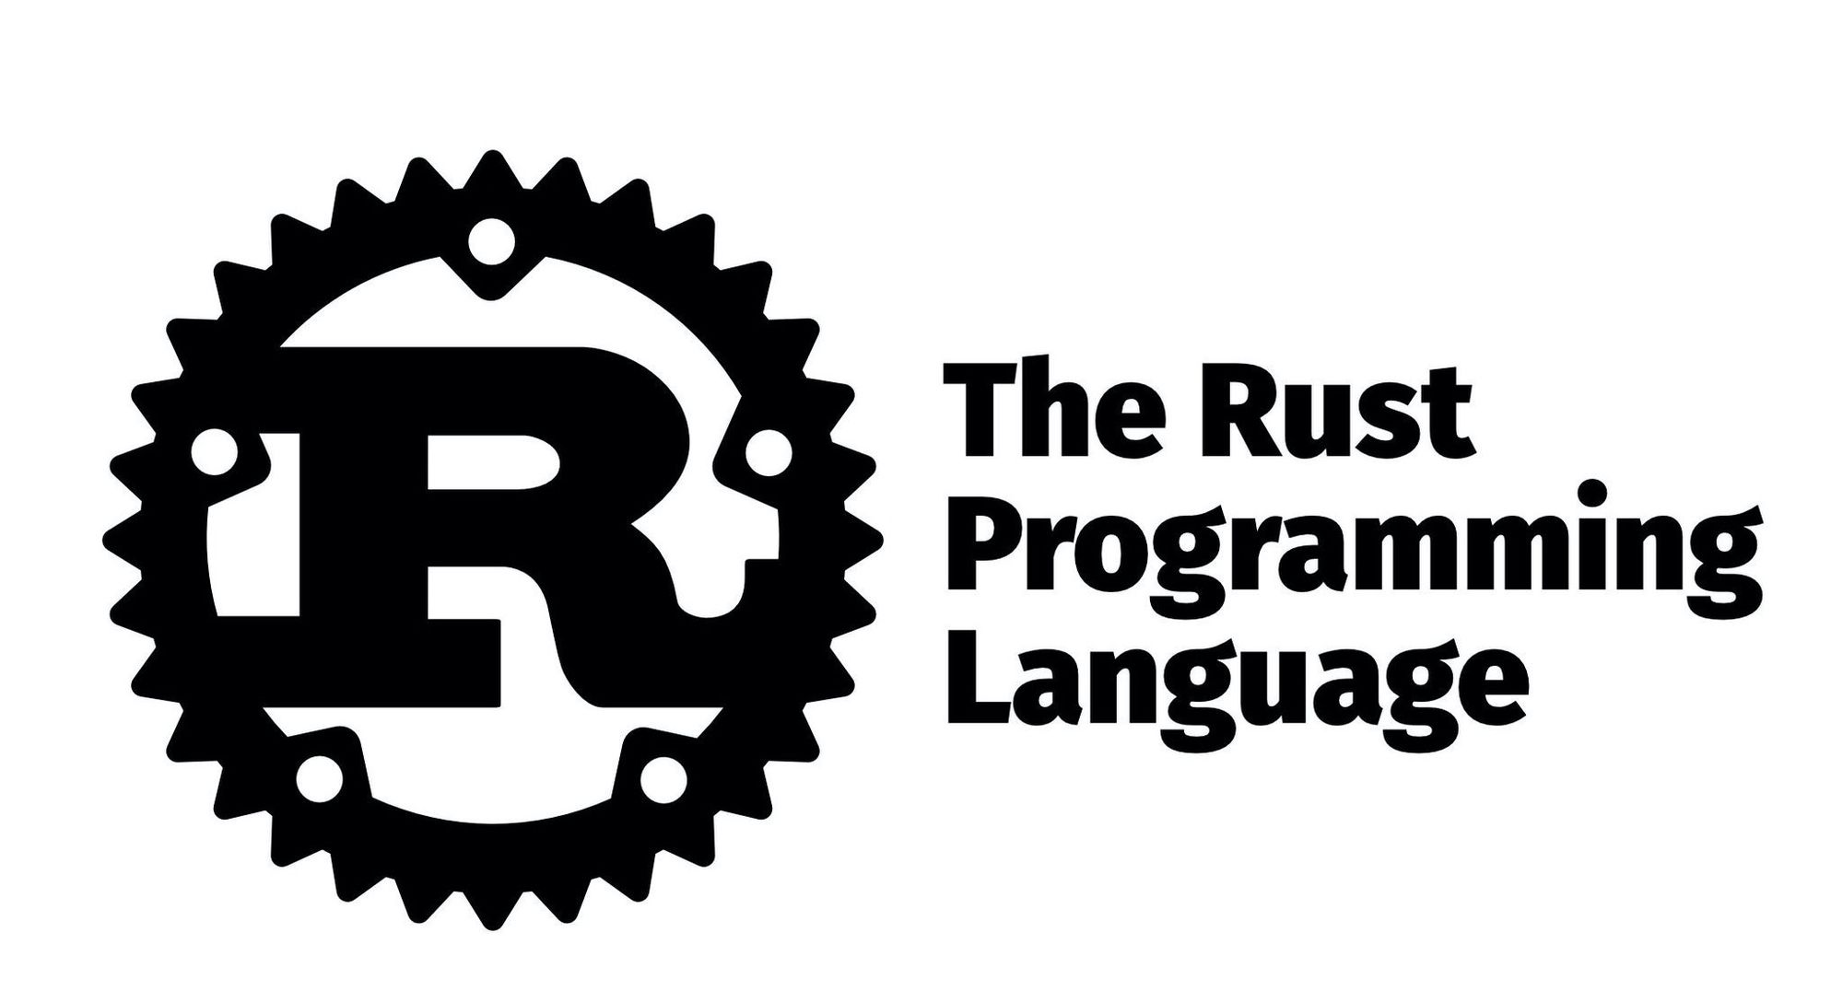
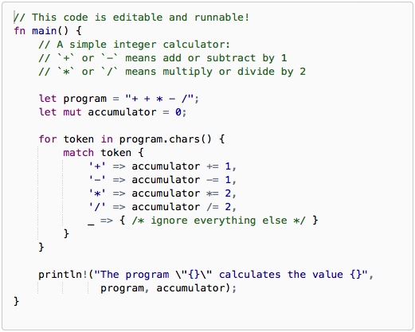
LECTURE 40: Emerging Languages – Rust
Topics:
Hello World
Syntax
Simple Examples
Resources:
The Rust Programming Language
Introduction to Rust
Rust by Example
Rust (Wiki)
Rust Overview (SlideShare)

Slide 2
Summary
Why Rust? Rust is a modern, systems programming language that prioritizes memory safety, performance, and concurrency.
What programming model does Rust follow? Rust does not enforce a programming paradigm, but was influenced by ideas from functional programming, including immutability, higher-order functions, algebraic data types, and pattern matching.
When was Rust created? Software developer Graydon Hoare created Rust as a personal project while working at Mozilla Research in 2006. Mozilla officially sponsored the project in 2009.
How widely has Rust been adopted? In the years following the first stable release in May 2015, Rust was adopted by companies including Amazon, Discord, Dropbox, Google (Alphabet), Meta, and Microsoft. In December 2022, it became the first language other than C and assembly to be supported in the development of the Linux kernel.
Is the Rust community growing? Rust has been noted for its rapid adoption, and has been studied in programming language theory research.

