Slide 1
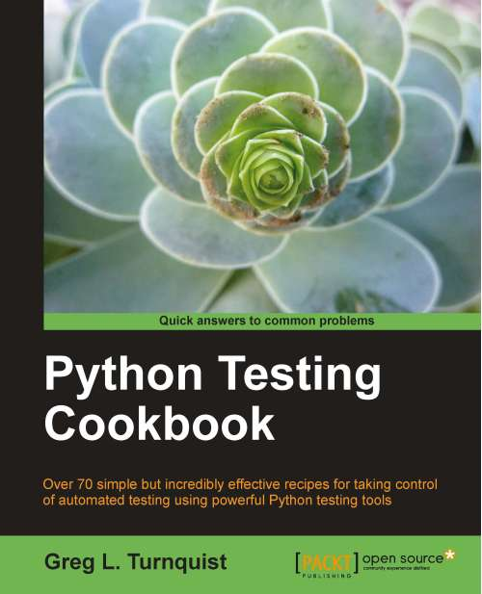
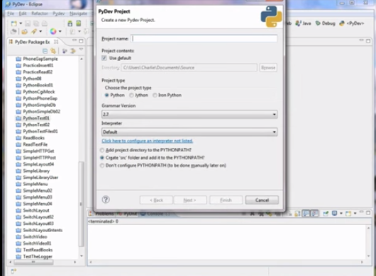
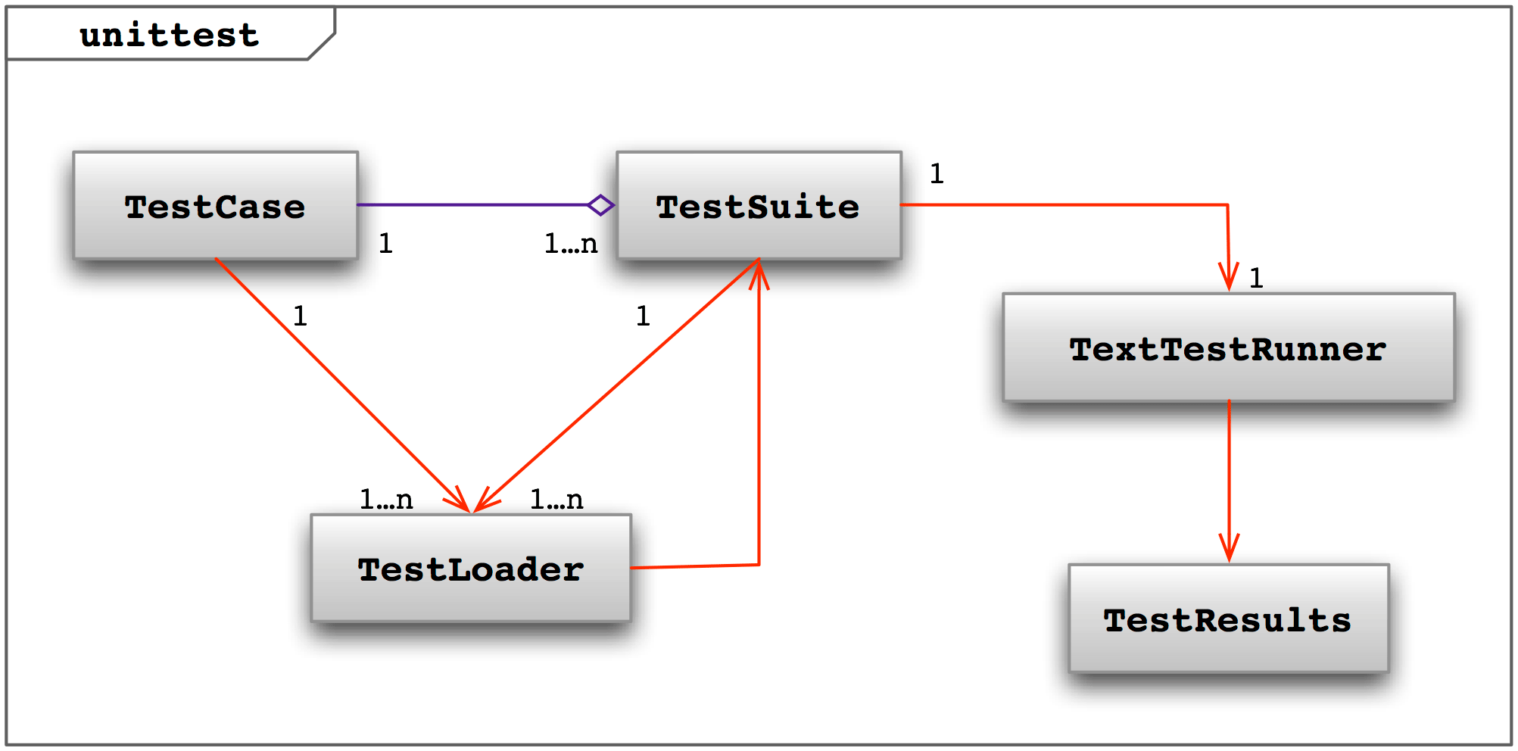
LECTURE 38: C++/Python - Unit Testing
Topics:
Testing As You Code
Class Syntax For Testing
Examples
Resources:
Geeks: PyUnit
Python: Unittest
LearnEnough: Python Unit Testing
JK: C++ Unit Testing

