Slide 1
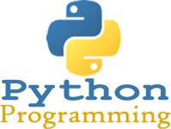
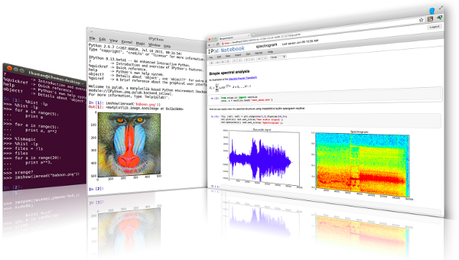
Lecture 35: C++/Python – Exception Handling and Multithreading
Topics:
Error Codes in C++
Error Handlers and Messages
C++ Techniques: Throw/Catch Try/Except
Built-In Exceptions
Multithreading
Resources:
ISO: Error Handling in C++
GfG: Python Exception Handling
Python: Built-in Exceptions
GfG: Multithreading
TP: Multithreading

Slide 2
Summary
Error Handling in C++: two popular ways to trap errors:
Error codes combined with if/else statements
Throw/catch:
int main () {
try { throw 20; }
catch (int e) {cout << "An exception occurred. Exception Nr. " << e << '\n’;}
return 0;
}
Error Handling in Python: try/except are the equivalent of throw/catch.
try:
f = open(sys.argv[1])
s = f.readline()
i = int(s.strip())
except IOError as e:
print("I/O error({0}): {1}".format(e.errno, e.strerror))
except ValueError:
print("Could not convert data to an integer.")
except:
print("Unexpected error:", sys.exc_info()[0])
raise
print("hello world")
Multithreading: use the threading library (start/join)

