Slide 1
Institute of Electrical and Electronics Engineers ECE 1111 Class
Notes:
Lloyd

Slide 2
What is IEEE?
Global Organization
Networking
Career Development
IEEE has 400,000+ members across 160+ countries
Members can access a vast network of professionals, form engineers to tech innovators
IEEE provides resources for career growth including conferences, publications, and training

Slide 3
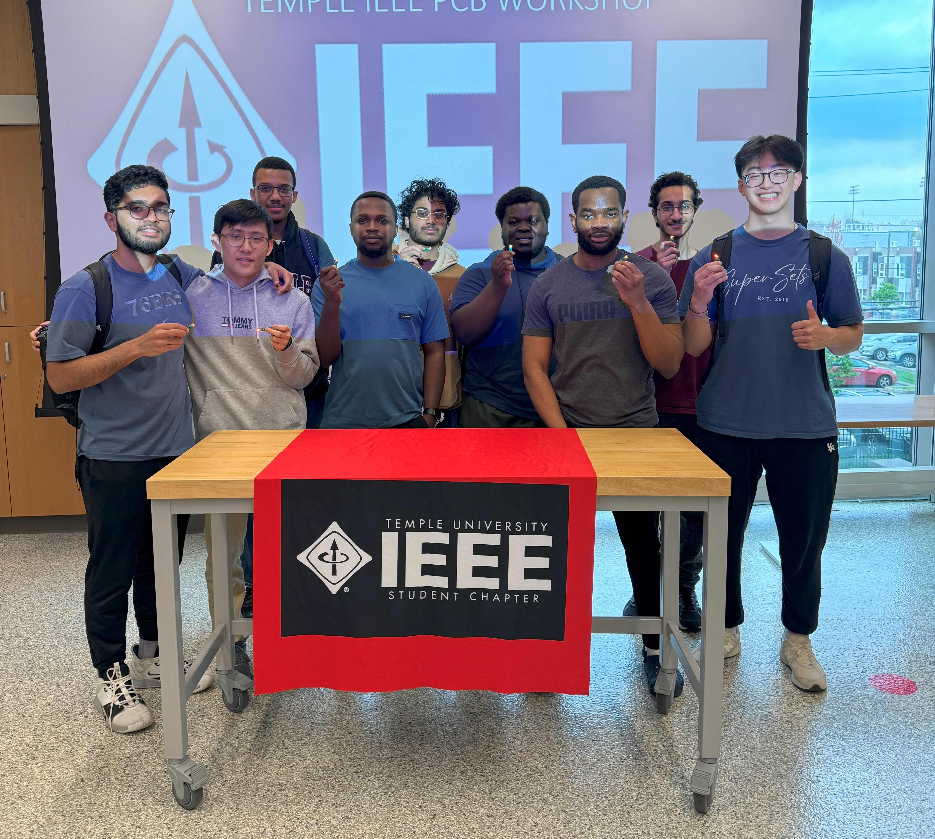
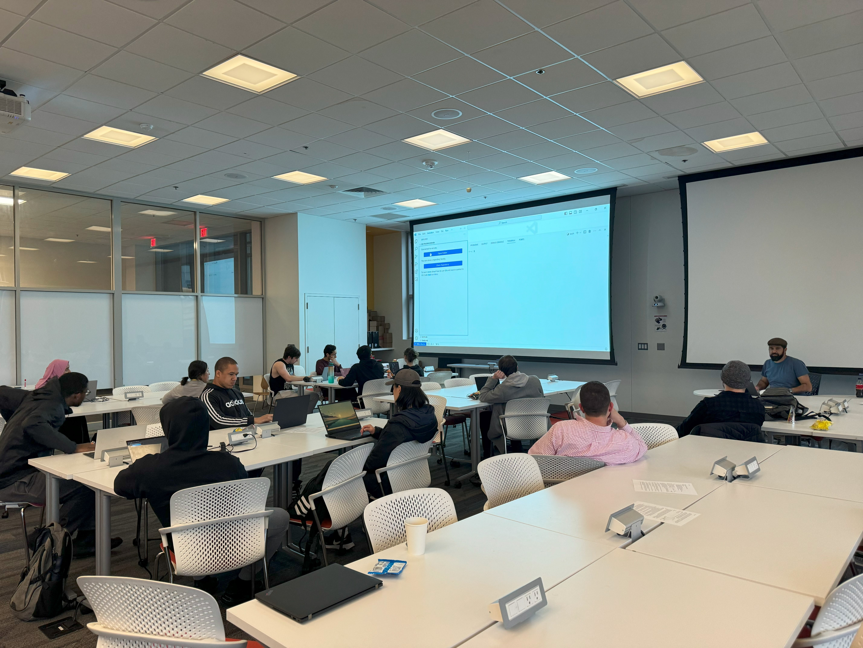
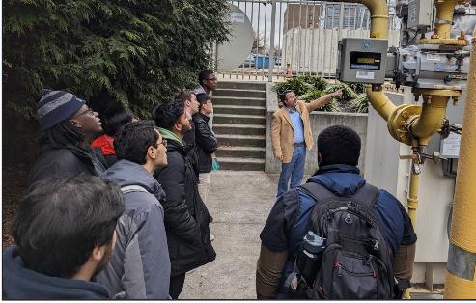
Temple IEEE Student Chapter Events
Toured the mechanical/electrical components of the PGW headquarters
Git/Github workshop with Dr. Obeid
PCB design/soldering workshop
Arduino workshops
Notes:
Brian

Slide 4
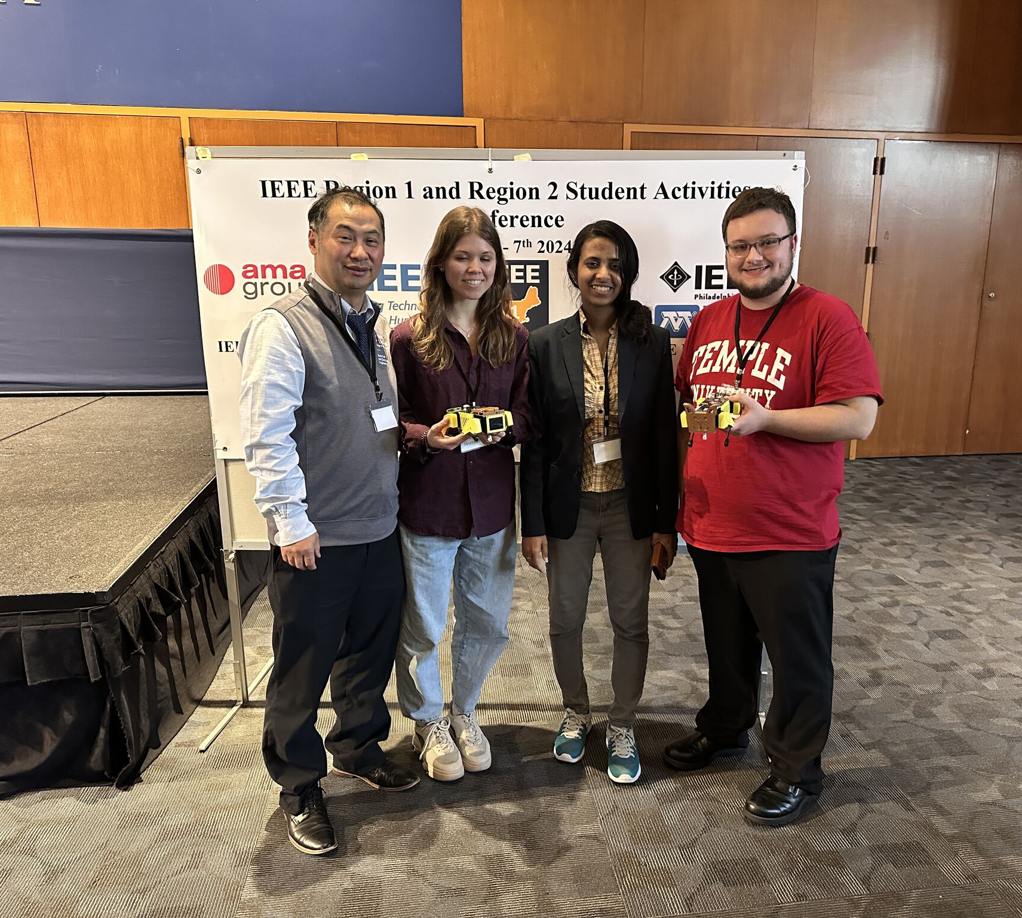
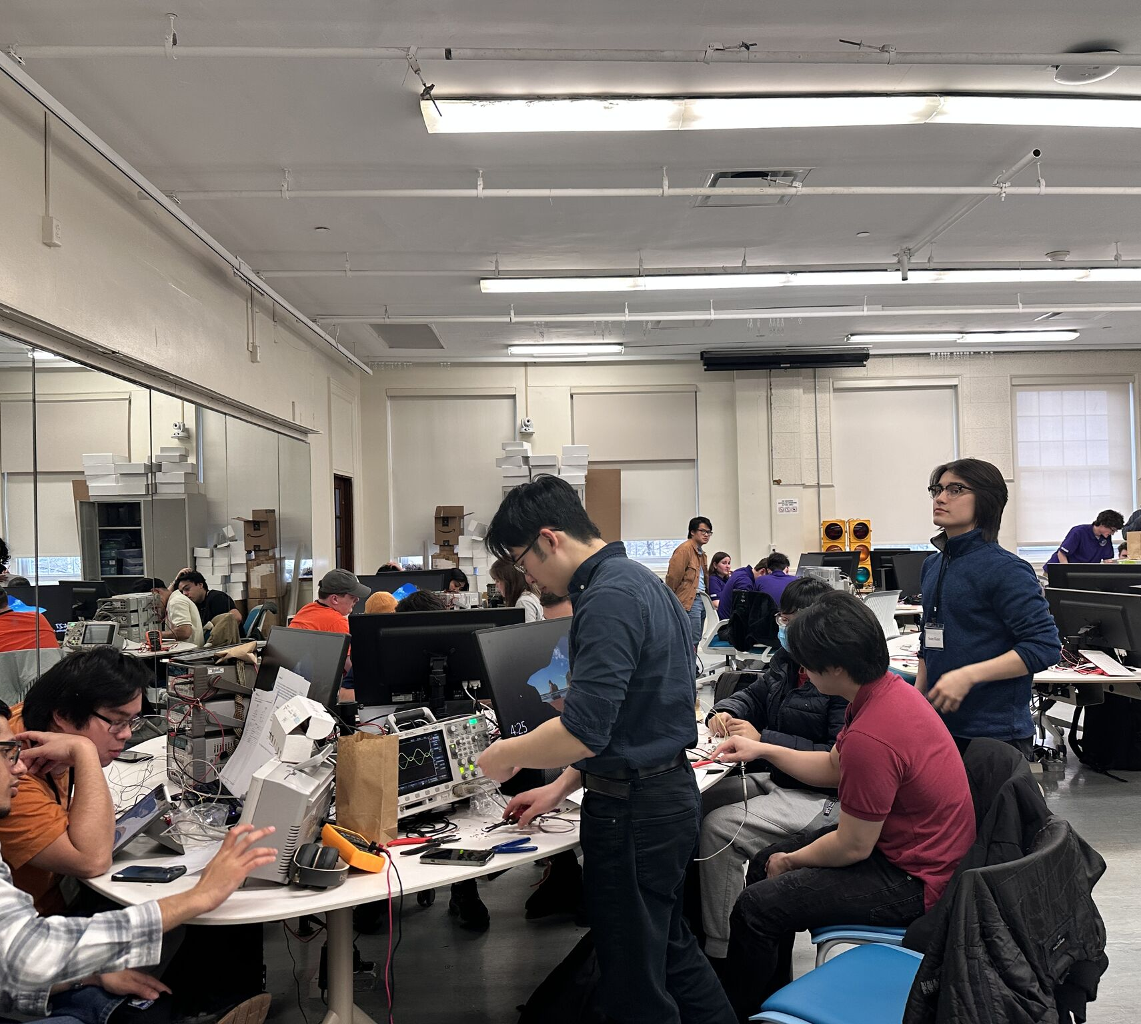
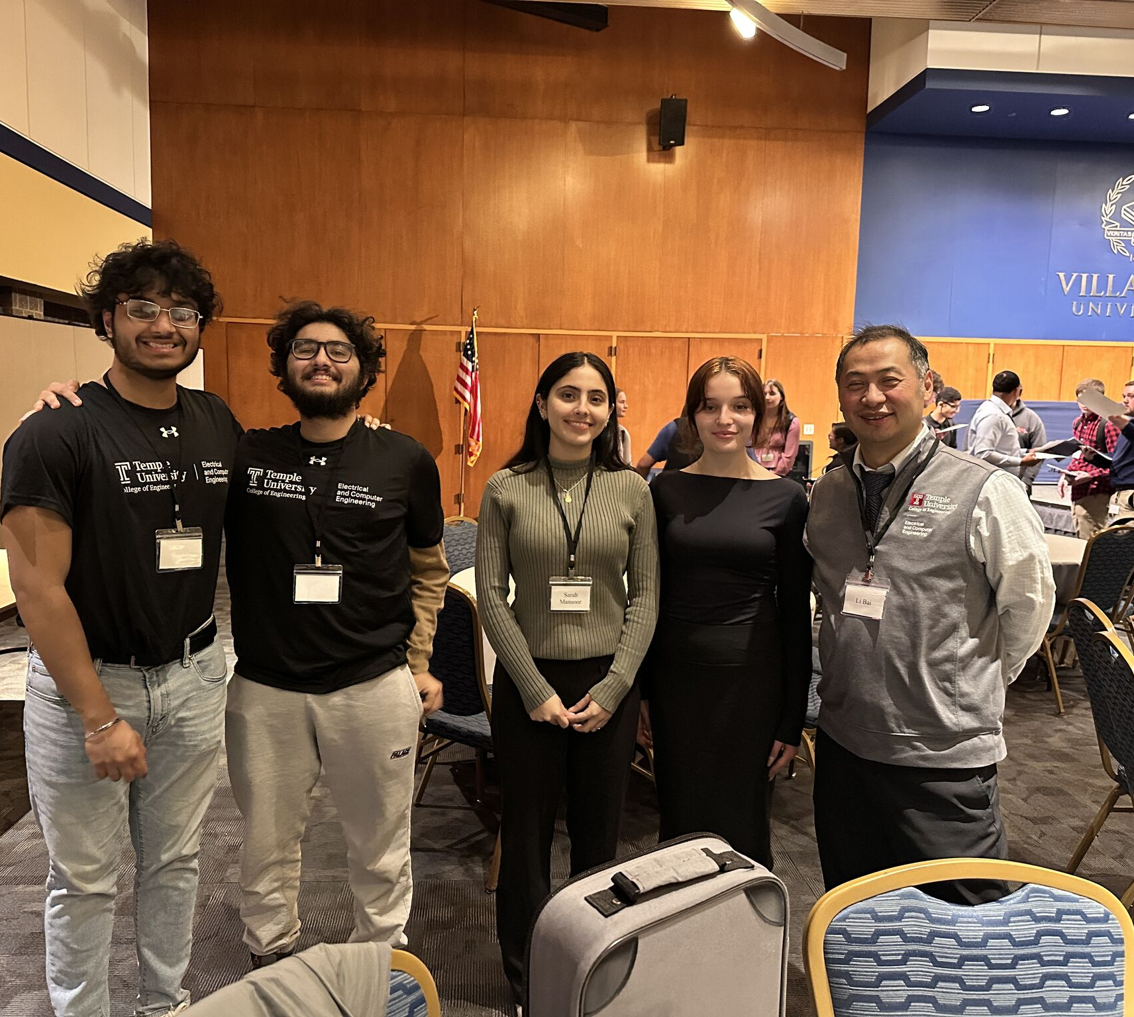
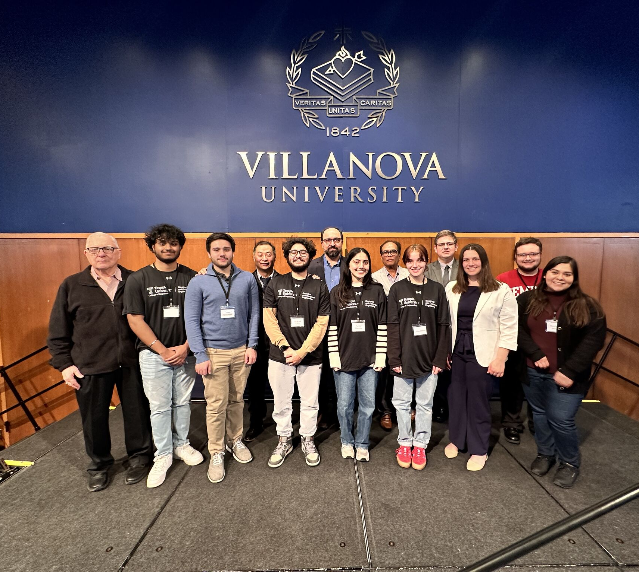
IEEE R1/R2 Student Activities Conference
Last conference was held at Villanova
Next year will be at Stony Brook University (New York)
Great opportunity to meet other students in EE and ECE
Compete in competitions and win prizes (money and awards)
Temple competed in the Sumobot, Ethics, and Presentation Competitions
*All expenses paid with an IEEE National membership
Notes:
Sarah and Lillian in the ethics
Shazad and Sahil in the Sumo bots
Stephanie and Chris presented their project with minipuppers

Slide 5
Benefits of National Membership
Priority Access to Temple IEEE Events, Student Activity Conference
More funding for Temple IEEE events
Global network of over 400,000 peers
Access to IEEE scholarships
Ability to be nominated for various awards for outstanding achievements
Networking opportunities with IEEE members (professionals and students)
Subscriptions to various professional magazines
Ability to be nominated for various honor societies and affinity groups
Continuing education benefits
Sign up at
IEEE.ORG
Notes:
Jake

Slide 6
THANK YOU!
Please Scan this to join the email list

