Slide 1
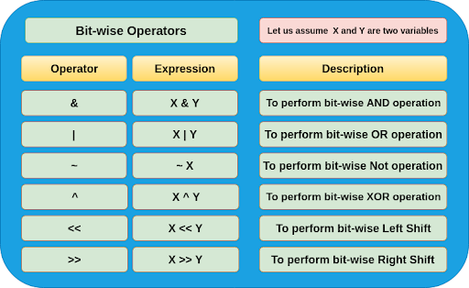
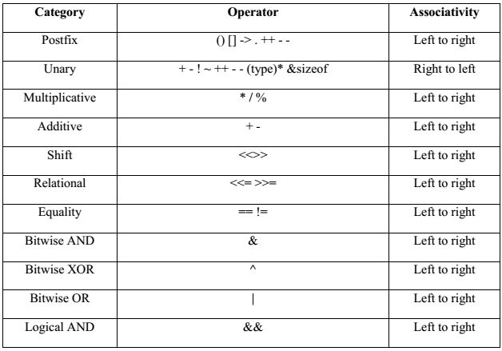
Lecture 17: C – Bitwise Operators
Topics:
Why Bitwise Operators?
Basic Logic Operations
The Six Basic Operators
Examples
Operator Precedence Revisited
Resources:
GeeksforGeeks: Bitwise Operators in C
TutorialsPoint: Bitwise Operators in C
Wiki: Bitwise Operations in C

Slide 2
Summary
Bits and Bytes: computers operate using a byte, which is collection of 8 bits. On an Intel processor, the “right-most” bit is the least significant bit.
Basic Logic Operators: the definition of logical operations such as ”and” and “or” can be found in this tutorial on basic logic gates.
Bitwise Operators:
▪ &: logical and ▪ |: logical or
▪ <<: left shift ▪ >>: right shift
▪ ~: one’s complement ▪ ^: exclusive or
Function Calls:
Prototype declaration in header file: float myfun(float, long);
Implementation in source code file: float myfun(float val1, long val2) {}
Key elements include a function name, arguments and a return value.
Functions can be overloaded (the same name, different arguments).
Operator Precedence Revisited: bitwise operators occupy levels 8-12 in the C Operator Precedence table that is part of the language definition. Note that the ‘logical and’ operator has the highest precedence (resolved first) and ‘logical or’ has the lowest precedence.

Slide 3
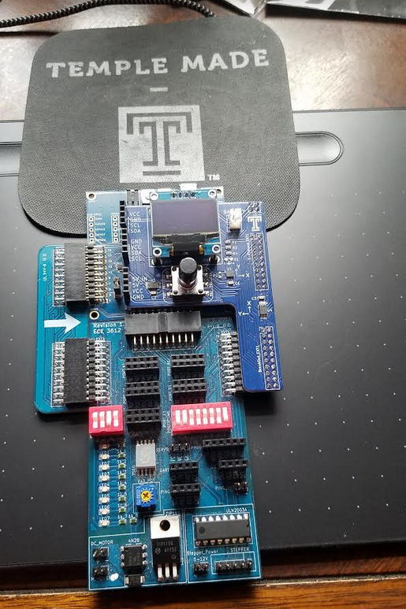
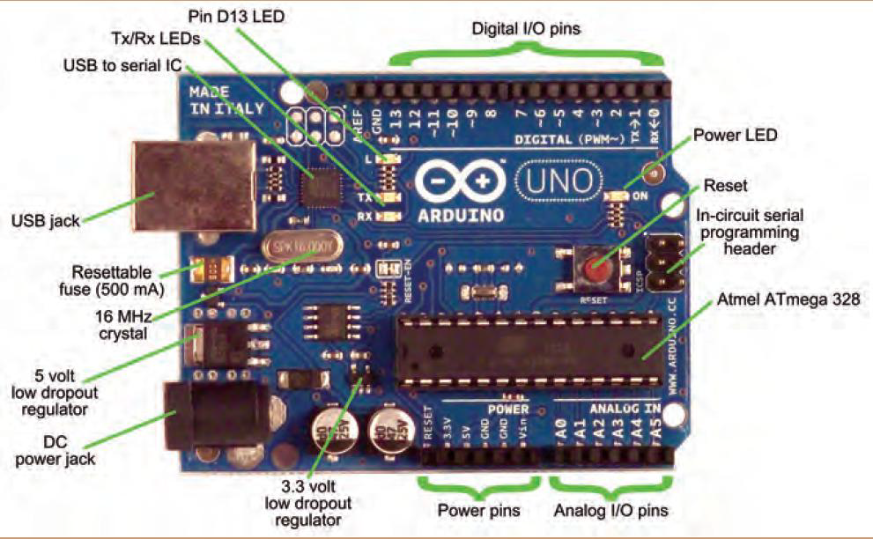
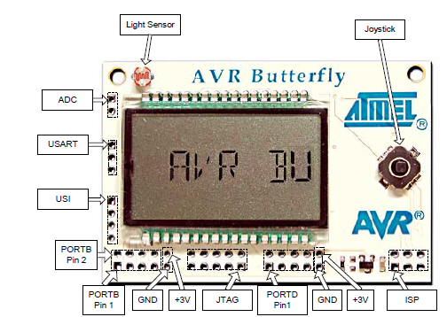
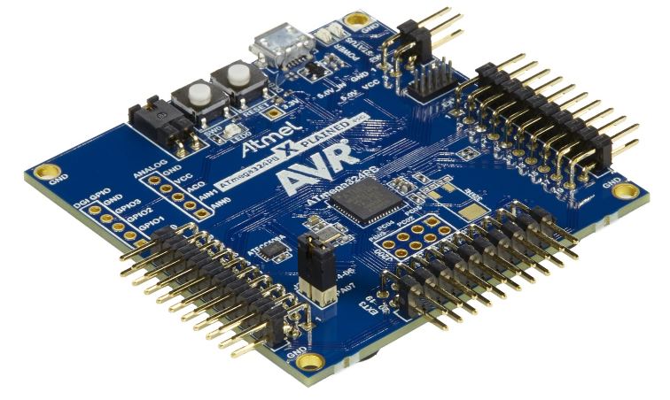
ECE 3612: Processor Systems
// mask porta to activate bit 7 to a 1
//
#define SW (PORTA&(1<<7));
#define F_CPU 8000000UL
#include "avr/io.h"
#include "util/delay.h"
void main() {
DDRA=0x7F;
DDRB=0x01;
while(1) {
if(SW == 1) {
//mask portb to activate bit 0 to a 1
PORTB = PORTB | (1<<0); delay_ms(75);
//(1<<0);mask portb to activate bit 0 to a 0
PORTB = PORTB & (~(1<<0));
_delay_ms(25);
}
else {
//mask portb to activate bit 0 to a 1
PORTB = PORTB | (1<<0);
delay_ms(50);
//mask portb to activate bit 0 to a 1
PORTB = PORTB & (~(1<<0)); );
_delay_ms(50);
}
}
}

