Slide 1
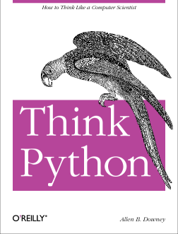
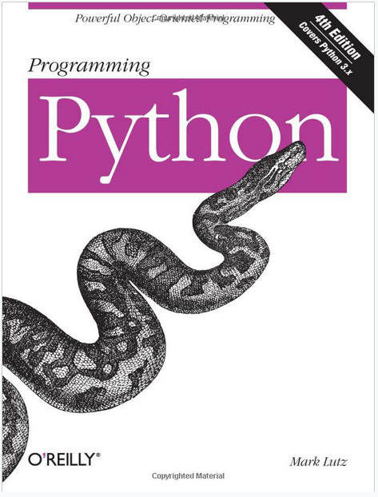
Lecture 04: Python: Program Structure and Libraries
Topics:
Good Books
Python Distributions
The Path Revisited
The Interpreter
Importing Libraries
The Main Program
Command Line Arguments
Resources:
Python: Getting Started
Python: Tutorial

Slide 2
Summary
Interpretive Language: Python does not need to be compiled (as we did with C/C++ using gcc). The run-time tools interpret the code line by line. Of course, this can make execution of Python code slow.
Python also can compile code (by generating a .pyc file) so that the next time you run the same code, it runs much faster.
Variables are not typed or declared – Python attempts to determine the types of data at run-time. This can be dangerous.
Python Distributions: We prefer a distribution known as Anaconda (https://www.anaconda.com/) because it contains many libraries needed to do basic engineering programming.
The Path Revisited: Python needs to know where to find imported libraries that are not in your current working directory. We typically handle this using environment variables.
The Main Program: Python can execute a sequence of commands line by line, or you can include a target that allows it to execute the main program as a function.
Common libraries to be imported include sys, os and numpy.
Command Line Arguments: very similar to C/C++. Use “sys.argv” to access command line arguments.

