Slide 1
LECTURE 41: Jobs, Jobs, Jobs…
Topics:
Guest Speaker
Gaining Programming Experience
Job Interviews
Career Paths
Resources:
What is a software engineer?
Navigating your career path
Stack Overflow Survey

Slide 2
Summary
A software engineer applies mathematical analysis and the principles of computer science in order to design and develop computer software.
The software engineering market (2023) is as competitive as it has ever been because there is a shortage of experienced senior developers who can quickly bring applications to market.
Electrical and computer engineers often work on embedded systems.
Embedded Software Engineering is the process of controlling various devices and machines that are different from traditional computers, using software engineering. Integrating software engineering with non-computer devices leads to the formation of embedded systems. A typical embedded system requires a wide range of programming tools, microprocessors and operating systems. Embedded software engineering, performed by embedded software engineers, needs to be tailored to the needs of the hardware that it has to control and run on.
Updating your skills regularly is critical in a rapidly evolving field like software engineering. Look for jobs that provide training or allow you to develop code using leading-edge tools.
DevOps, Full-Stack Development and Real-time Operating Systems are just a few of the many opportunities that are in great demand.

Slide 3
Secrets to a Satisfying Career in Computer Engineering ✨
Steve Bergey
Senior Computer Security Researcher

Slide 4
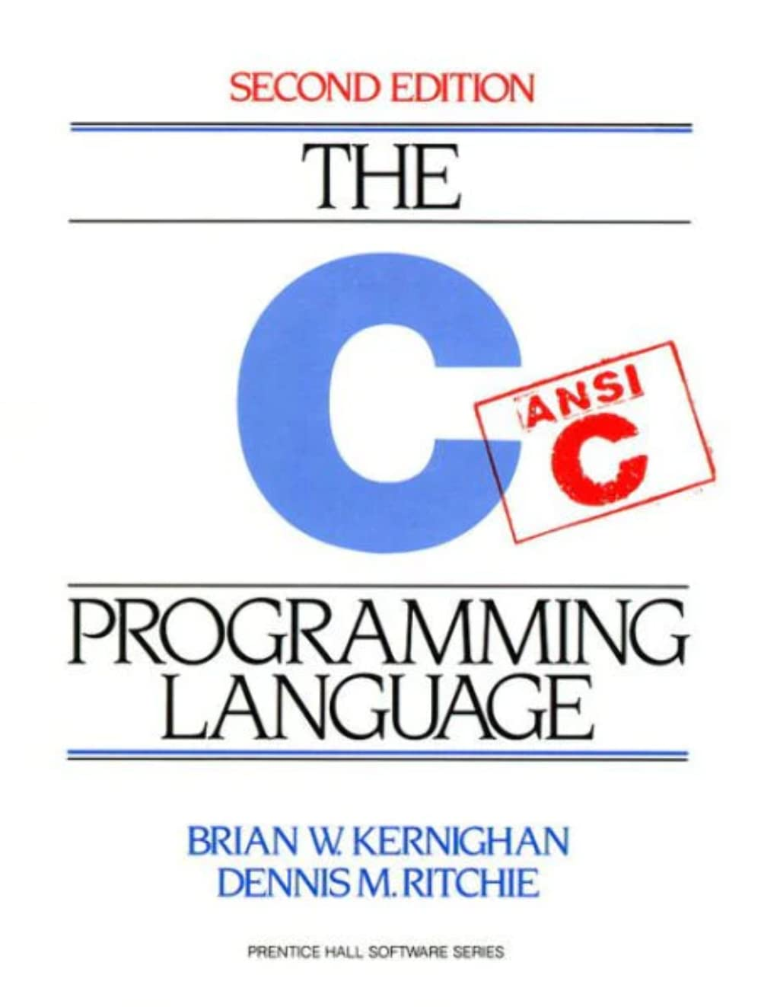
Conclusion
Get good at C
Notes:
All jokes aside, let’s explore this topic a bit deeper

Slide 5
👋 Introduction
Computer Security R&D @ Lockheed Martin Advanced Technology Laboratories (ATL)
Reverse engineering
Low-level development
Vulnerability research
Education
B.S. Electrical Engineering - Temple University (2014)
M.S. Electrical & Computer Engineering - Johns Hopkins University (2018)
* The opinions and content presented in this presentation are solely my own and not representative of my employer *

Slide 6
🛤️ My Career Journey
Junior Year: I don’t have any internships… who will hire me?! (2013)
Dr. Picone: “I’ll hire you”
Research Assistant at NEDC: Linux scripting, data analysis, NETWORKING
Dr. Picone: “You should apply for an internship at the National Security Agency”
Notes:
Side hustle fixing computers

Slide 7
🛤️ My Career Journey
Junior Year: I don’t have any internships… who will hire me?! (2013)
Dr. Picone: “I’ll hire you”
Research Assistant at NEDC: Linux scripting, data analysis, NETWORKING
Dr. Picone: “You should apply for an internship at the National Security Agency”
Senior Year: Interned at NSA (2014)
NETWORKING!
Notes:
Side hustle fixing computers

Slide 8
🛤️ My Career Journey
Junior Year: I don’t have any internships… who will hire me?! (2013)
Dr. Picone: “I’ll hire you”
Research Assistant at NEDC: Linux scripting, data analysis, NETWORKING
Dr. Picone: “You should apply for an internship at the National Security Agency”
Senior Year: Interned at NSA (2014)
NETWORKING!
Capabilities Development Specialist @ NSA (2015-2016)
N E T W O R K I N G !
Friends with a number of coworkers 8 years later, frequent job opportunities
Job security - knowing people who can vouch for you in a new position
Notes:
Side hustle fixing computers

Slide 9
🛤️ My Career Journey
Junior Year: I don’t have any internships… who will hire me?! (2013)
Dr. Picone: “I’ll hire you”
Research Assistant at NEDC: Linux scripting, data analysis, NETWORKING
Dr. Picone: “You should apply for an internship at the National Security Agency”
Senior Year: Interned at NSA (2014)
NETWORKING!
Capabilities Development Specialist @ NSA (2015-2016)
N E T W O R K I N G !
Friends with a number of coworkers 8 years later, frequent job opportunities
Job security - knowing people who can vouch for you in a new position
Embedded/IOT Security Research @ River Loop Security (2018-2020)
Side-gig, opportunity arose from… networking
Notes:
Side hustle fixing computers

Slide 10
🛤️ My Career Journey
Junior Year: I don’t have any internships… who will hire me?! (2013)
Dr. Picone: “I’ll hire you”
Research Assistant at NEDC: Linux scripting, data analysis, NETWORKING
Dr. Picone: “You should apply for an internship at the National Security Agency”
Senior Year: Interned at NSA (2014)
NETWORKING!
Capabilities Development Specialist @ NSA (2015-2016)
N E T W O R K I N G !
Friends with a number of coworkers 8 years later, frequent job opportunities
Job security - knowing people who can vouch for you in a new position
Embedded/IOT Security Research @ River Loop Security (2018-2020)
Side-gig, opportunity arose from… networking
Computer Security R&D @ Lockheed Martin ATL (2016+)
Random recruiter email :)
Notes:
Side hustle fixing computers

Slide 11
⏰ A Day in the Life
Common problems to solve
Is it possible to do X? If so, what are some solutions?
How does this program work?
How does this system communicate with that system?
What this looks like…
Reading (yes, we really get paid to read)
Exploring
Planning
Executing
Notes:
Common problems to solve
Is it possible to do X? If so, what are some solutions?
How does this program work?
How does this system communicate with that system?
What this looks like…
Reading: blogs, academic papers, technical documents…
Am I really getting paid to read?!
Exploring: Recreating academic experiments, trying tools found on Github, writing code
Planning: Determining the best way to solve the problem, discussing with coworkers/teammates
Executing: Writing code, writing a report/slides, performing demos
Am I really getting paid to make powerpoint slides?!
Goals are clear - how you get there is very open-ended

Slide 12
GOALS ARE CLEAR
how you get there is very open-ended…

Slide 13
🔑 Key Skills for Comp. Eng.
C
Complete control
Know exactly what and how it’s running
Forces you to understand what’s really happening

Slide 14
🔑 Key Skills for Comp. Eng.
C
Complete control
Know exactly what and how it’s running
Forces you to understand what’s really happening
System Design
High-level understanding of all components and how they interact
A good design will save tons of time and money
Helps you get quickly spun-up on new/existing projects

Slide 15
🔑 Key Skills for Comp. Eng.
C
Complete control
Know exactly what and how it’s running
Forces you to understand what’s really happening
System Design
High-level understanding of all components and how they interact
A good design will save tons of time and money
Helps you get quickly spun-up on new/existing projects
Problem Solving: The Heart of Engineering
How does this work? Why isn’t this working? Can this work?
Requires strong mix of creativity and logical reasoning

Slide 16
LEARN TO LEARN NEW THINGS QUICKLY…

Slide 17
🚀 Preparing for a Career in Comp. Eng.
Strong understanding of C and how computers work
High-level understanding of “how computers work” is the quickest way to demonstrate raw technical skill
Computer Arch, Networking, Compilers

Slide 18
🚀 Preparing for a Career in Comp. Eng.
Strong understanding of C and how computers work
High-level understanding of “how computers work” is the quickest way to demonstrate raw technical skill
Computer Arch, Networking, Compilers
Passion
Personal projects highlighting skills and enthusiasm

Slide 19
🚀 Preparing for a Career in Comp. Eng.
Strong understanding of C and how computers work
High-level understanding of “how computers work” is the quickest way to demonstrate raw technical skill
Computer Arch, Networking, Compilers
Passion
Personal projects highlighting skills and enthusiasm
Networking
Build professional relationships
Tech meetups
Conferences
Online communities
Seek mentors who can provide career guidance and insights

Slide 20
🚀 Preparing for a Career in Comp. Eng.
Strong understanding of C and how computers work
High-level understanding of “how computers work” is the quickest way to demonstrate raw technical skill
Computer Arch, Networking, Compilers
Passion
Personal projects highlighting skills and enthusiasm
Networking
Build professional relationships
Tech meetups
Conferences
Online communities
Seek mentors who can provide career guidance and insights
Resources for staying up to date
X (R.I.P Twitter), Hacker News (YCombinator), Reddit

Slide 21
BE READY TO APPLY NEW TECHNOLOGY TO OLD PROBLEMS

Slide 22
💼 Interview Advice
Genuine passion and enthusiasm
This can greatly make up for lack of experience
Side projects, clubs, …

Slide 23
💼 Interview Advice
Genuine passion and enthusiasm
This can greatly make up for lack of experience
Side projects, clubs, …
Problem-solving skills
Requires good communication to convey your thought process
“I don’t know the answer, but if I had to reason…”

Slide 24
💼 Interview Advice
Genuine passion and enthusiasm
This can greatly make up for lack of experience
Side projects, clubs, …
Problem-solving skills
Requires good communication to convey your thought process
“I don’t know the answer, but if I had to reason…”
Ask questions
Genuine interest in the role, understanding if the job is a good fit
Mid-interview questions are rare - can make a memorable impact
“Wait are we also being interviewed here?”

Slide 25
💼 Interview Advice
Genuine passion and enthusiasm
This can greatly make up for lack of experience
Side projects, clubs, …
Problem-solving skills
Requires good communication to convey your thought process
“I don’t know the answer, but if I had to reason…”
Ask questions
Genuine interest in the role, understanding if the job is a good fit
Mid-interview questions are rare - can make a memorable impact
“Wait are we also being interviewed here?”
Resume
Do not include anything you aren’t prepared to elaborate on!

Slide 26
💡Concluding Thoughts
A SOLID GRASP OF C WILL NOT STEER YOU WRONG
Notes:
Talk here about my experience with self-doubt and how much things changed once I got over it

Slide 27
💡Concluding Thoughts
ALWAYS LOOK TO EXPAND YOUR PROFESSIONAL NETWORK
Notes:
Talk here about my experience with self-doubt and how much things changed once I got over it

Slide 28
💡Concluding Thoughts
EMBRACE OPPORTUNITIES AND OVERCOME DOUBT!
Notes:
Don’t let self-doubt keep you from applying to a position
Passion and enthusiasm can greatly overcome lack of grades and experience

Slide 29
QUESTIONS?

Slide 30
THANK YOU ✨
email: contact@stevenbergey.com

