Slide 1
Temple Robotics
President: Jared Levin
Vice President: Jay Pande

Slide 2
Overview
Why Software and Robotics Matter
The Robot
Competition

Slide 3
Software & Robotics
Learn to Research and Write Code
Real World Linux Usage
Applied Programming in a Professional Field

Slide 4
The Robot
Previous Robot Named J.A.R.E.D
Creating a New Robot this Year

Slide 5
Competition
Astrobotics at University of Alabama
NASA Lunabotics at Kennedy Space Center
More TBD???

Slide 6
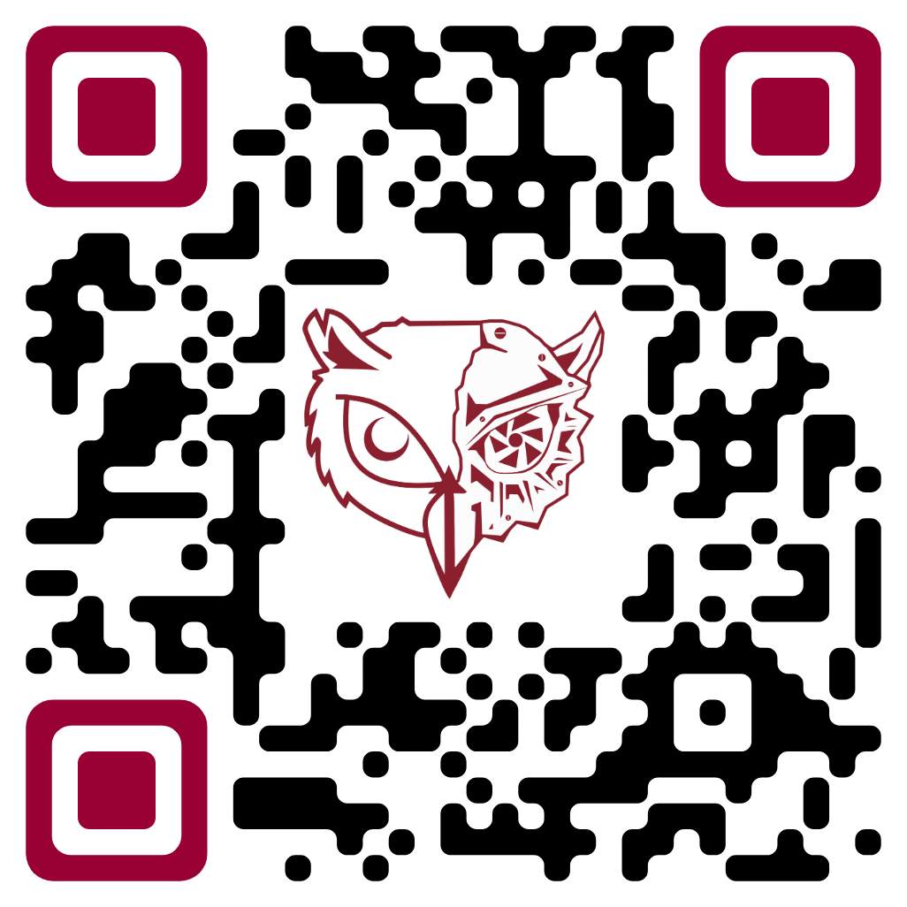
Join Us

