Slide 1
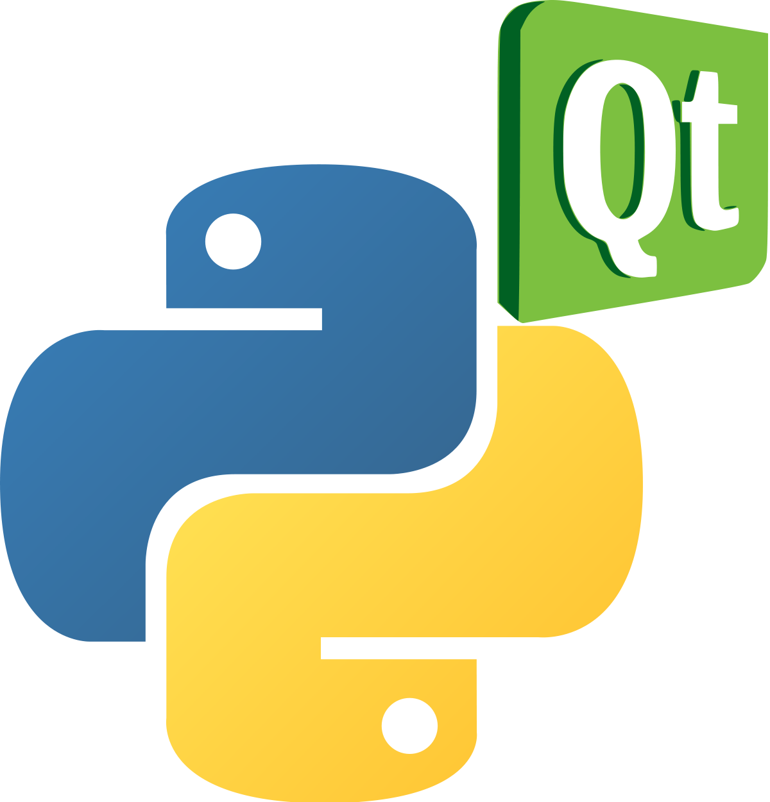
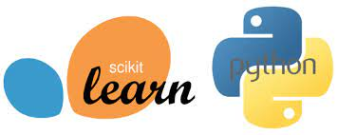
Lecture 40: Python: Structured Programming and Libraries
Topics:
Building Environments
Python Class Libraries
Python Application Programming
Resources:
PyQT5: GUIs and Graphics
Scikit-Learn: Machine Learning
PyTorch: Advanced Maching Learning

Slide 2
Summary
PyQT provides a reasonable set of tools to build graphical user interfaces quickly.
Scikit-Learn and PyTorch are major packages for machine learning.
Users will often use a combination of standard Python libraries, group-wide or company-wide libraries and local libraries.

