Slide 1
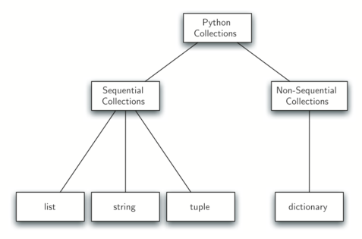
Lecture 32: File I/O and Directory Traversal
Topics:
Opening and Reading Files
Text and Binary I/O
Directory Traversal
Resources:
TutorialsPoint: Reading Binary Files
GeeksForGeeks: Directory Traversal

Slide 2
Summary
Scripting Languages: because Python is a scripting language, interacting with the operating system and leveraging operating system capabilities is fairly easy. This is one reason it is popular. Scripts can easily interact with the operating system.
Directory Traversal: very easy to write a script that ‘walks’ through a file system using the os library.
Note that the order in which files are visited depends not on a specific sort order, but the order they appear in the file system index (last in, first out like the find command).
File I/O: supports ASCII, binary and an assortment of other file I/O modes. It emulates the way we access files in C/C++.
Reading files into a list is easily done with a one line piece of code, but such compactness can make code hard to debug and/or use lots of memory.
Be careful when reading files as text – Python inserts a lot of “intelligent” character processing that can fail if you don’t open a file with the proper character encoding system:
with open(filename, 'r', encoding='utf8') as f:

