Slide 1
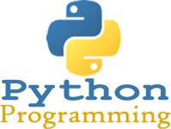
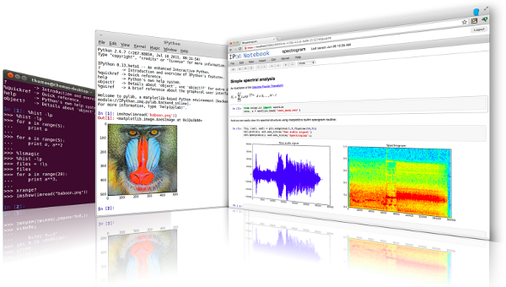
Lecture 35: Data Structures
Topics:
Lists
Stacks
Queues
List Comprehension
Tuples and Sequences
Sets
Dictionaries
Looping Revisited
Resources:
Python.org: Data Structures
Real Python: Data Structures
Coursera: Python Data Structures
TutorialsPoint: Data Structures

Slide 2
Summary
Lists: a container that functions much like an array; can be indexed numerically by position.
Stacks: last element added is the first element retrieved.
Queues: first element added is the first element retrieved.
List Comprehension: a functional programming tool that allows efficient implementation of iterative operations (e.g., iterating over a list and computing some function for each element)
Tuples: Similar to a list but initialized using a comma-separated list.
Sequence Unpacking: Tuples can be efficiently unpacked into individual elements.
Sets: Similar to an enum in C++, an unordered collection with no duplicate elements. Very useful in writing efficient code that sorts data into a unique list of elements.
Dictionaries: an associative array in which elements are referenced by a key.
Looping Revisited: We can loop over data structures in an abstract way, or explicitly by index or key.

