Slide 1
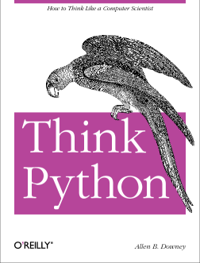
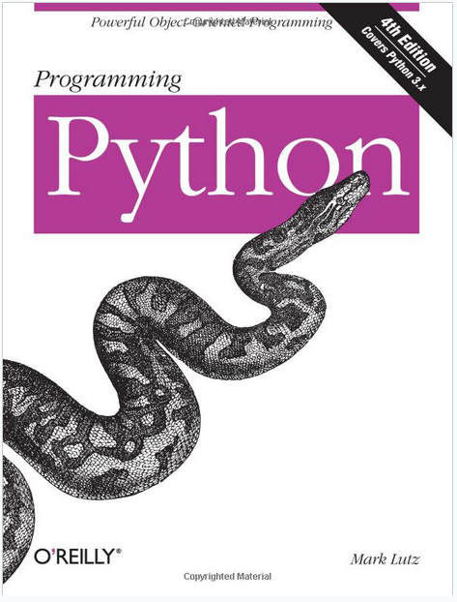
Lecture 34: Classes and Object-Oriented Design
Topics:
Class Declaration
Public/Private/Protected Data
Data Initialization
Member Functions
Resources:
Lynda: Up and Running
YouTube: Google Python
YouTube: MIT Python
YouTube: O'Reilly Python
Python: Getting Started
Python: Tutorial
Python.eu: Tutorial

Slide 2
Summary
Classes in Python are very similar to C++:
The reserved word “class” is used to denote the start of a class definition.
The reserved word “def” is used to denote the start of a member function.
The reserved word “self” is similar to “this” in C++.
Constructor syntax is a little tricky:
def __init__(self):
Syntax in the calling program is straightforward:
toaster = Toaster();
toaster.myprint();
Flexible argument referencing for function calls:
toaster1.myset(model = "bosch", width=float(99), length=float(35))
Two main differences:
Usually let the garbage collector handle destruction of objects.
Many programs do not protect class data (e.g., ’protected’ and ‘private’ are not commonly used).

