Slide 1
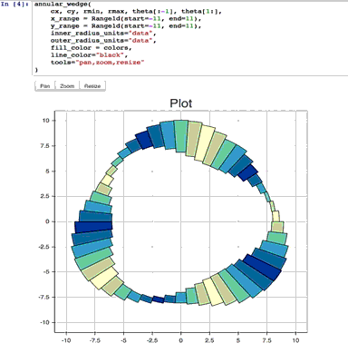
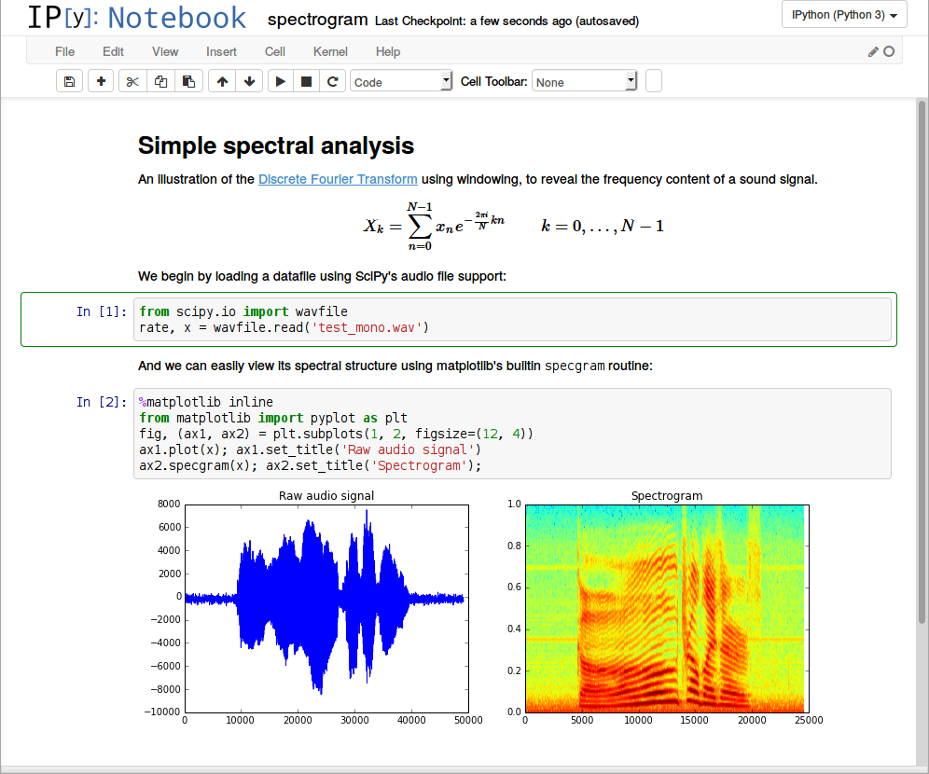
Lecture 40: Jupyter Notebooks
Topics:
The Notebook Interface
Files and Directories
Cells and Kernels
Output Formats
Resources:
How to Use Jupyter Notebook in 2020: A Beginner’s Tutorial
Jupyter Notebook Tutorial: The Definitive Guide
Jupyter Tutorial
Jupyter Notebook Introduction
Making Plots in Jupyter Notebooks

Slide 2
Summary
Notebooks are an excellent way to document an engineering process because they allow you to combine nicely formatted text with code and results.
These capabilities exist in many tools including MATLAB.
Jupyter notebooks use a serialized data storage format, JSON, to store the document.
They allow you to integrate many different text processing formats, including HTML, Markdown and LaTex (a popular word processor in STEM).
Notebooks are integrated into Anaconda.
Jupyter notebooks use a browser-like interface.
To use them on our server (ece-000), do the following:
On ece-000:
jupyter notebook --no-browser --port=8889
On your local host:
ssh -N -f -L localhost:8888:localhost:8889 username@ece-000.eng.temple.edu
Open a browser on your local machine and enter:
localhost:8888

