Slide 1
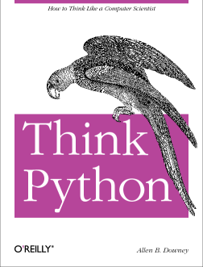
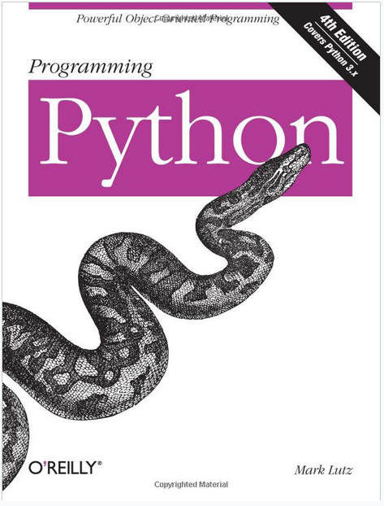
Lecture 31: Arrays, Lists, Dictionaries and Loops
Topics:
Lists
Arrays
Dictionaries
Loops
Resources:
Python: Loops and Conditionals
Python: Dictionaries Python: Data Structures Lynda: Up and Running
YouTube: Google Python
YouTube: O'Reilly Python
Python: Getting Started
Python: Tutorial

Slide 2
Summary
Lists: a container of objects. In C++, we call this a heterogenous list (or polymorphism).
Growable: can be appended or expanded at run-time.
Require more memory than an array. Why?
Can be indexed numerically.
List Comprehension: a compact notation that allows Python to execute list-related code faster.
Arrays: using the numpy library, we can have compact arrays comparable to arrays in C/C++.
Can be multidimensional.
Dictionaries: an associative array.
Data is indexed by a key.
Starting with Python 3.7, dictionaries are ordered (you can assume items can be indexed numerically in the same order they were inserted).
You can iterate over a dictionary by key or by index or both.
Loops: you can iterate over a data structure in Python without explicitly knowing its length (very convenient).

