Slide 1
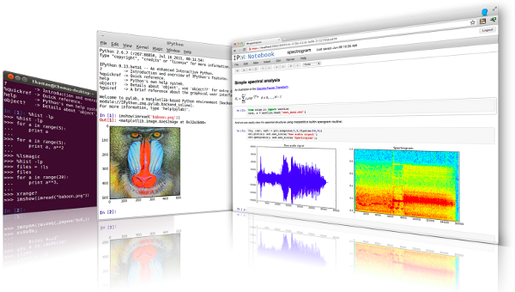
Lecture 38: Exception Handling and Multithreading
Topics:
Error Codes in C++
Error Handlers and Messages
C++ Techniques: Throw/Catch Try/Except
Built-In Exceptions
Multithreading
Resources:
ISO: Error Handling in C++
Python: Exceptions
Python: Built-in Exceptions
GfG: Multithreading
TP: Multithreading

