Slide 1
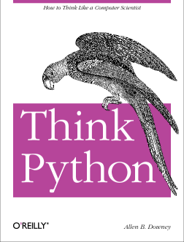
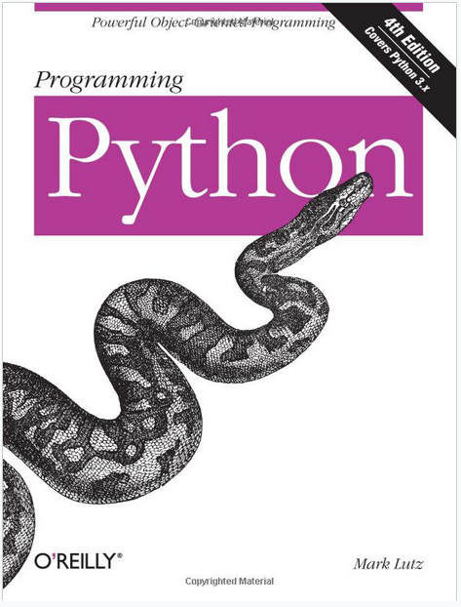
Lecture 34: Arrays, Lists, Dictionaries and Loops
Topics:
Arrays
Lists
Dictionaries
Loops
Resources:
Python: Loops and Conditionals
Python: Dictionaries Python: Data Structures Lynda: Up and Running
YouTube: Google Python
YouTube: O'Reilly Python
Python: Getting Started
Python: Tutorial

