Slide 1
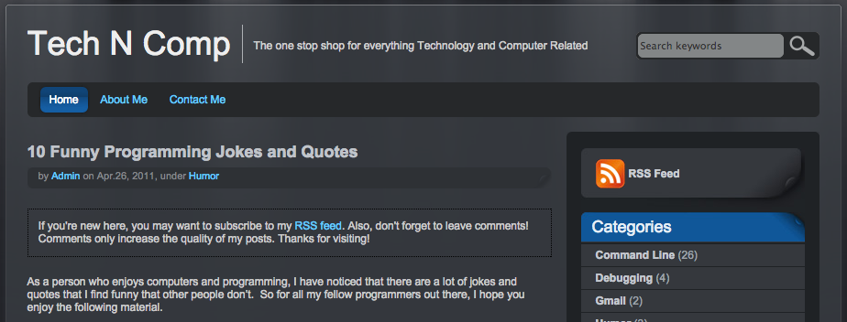
Lecture 03: Compiling and Debugging Code in Linux
Topics:
Gcc and gdb
Compilation and Linking
Assembly Code
Make Files
Resources:
LL: Compiling C/C++ Programs
LL: Essential C
YT: Using Gcc on Linux
YT: GNU Make
EZ: Generating Assembly Code

