Slide 1
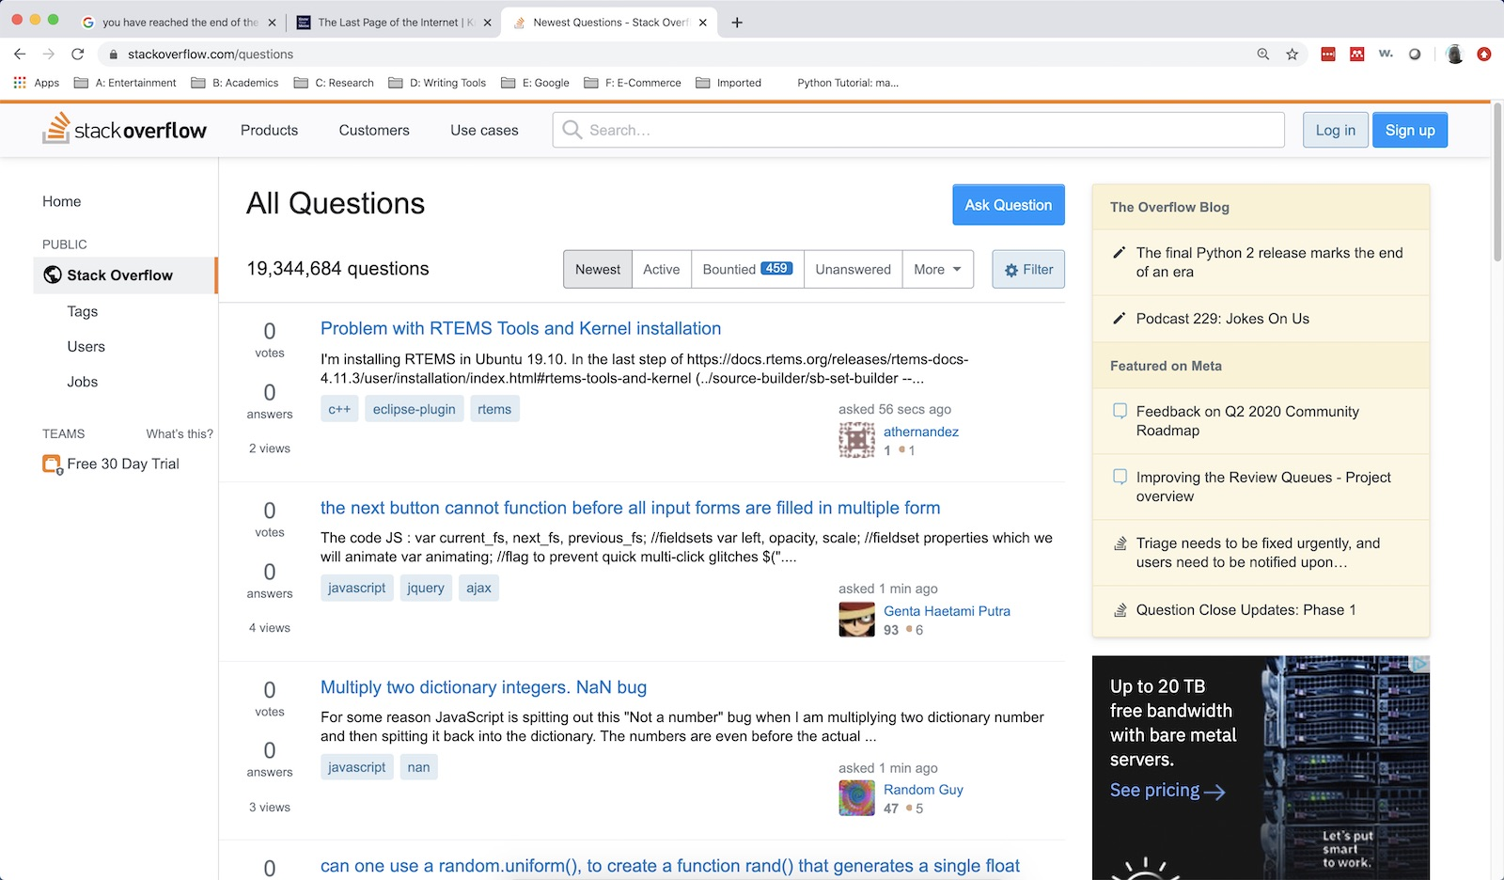
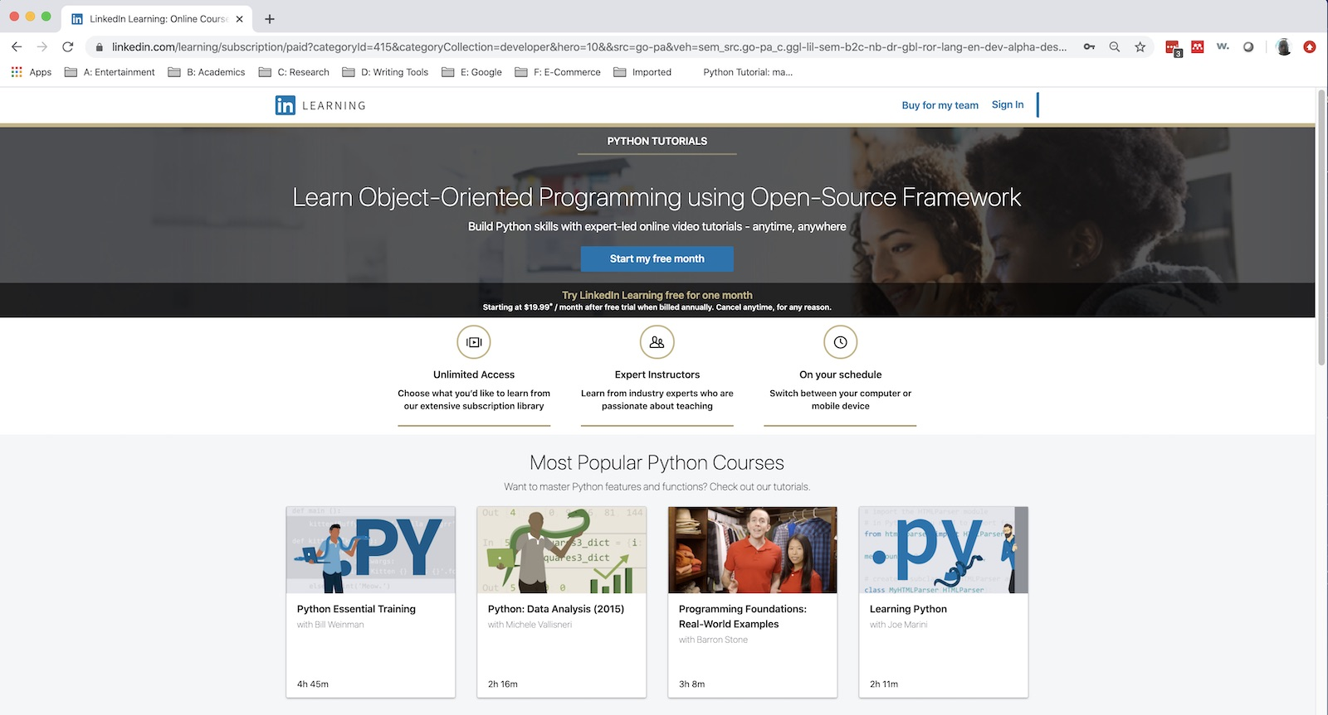
Lecture 42: Examples
Objectives:
File Parsing Text Processing
Resources:
StackOverflow ☺

