Slide 1
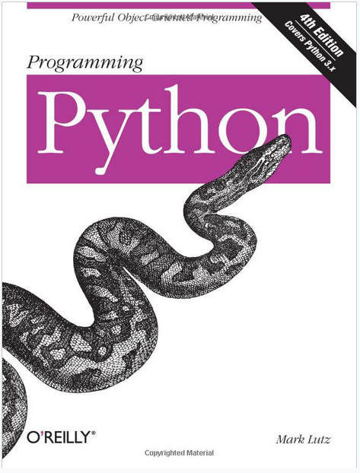
Lecture 40: Classes and Object-Oriented Design
Topics:
Class Declaration
Public/Private/Protected Data
Data Initialization
Member Functions
Resources:
Lynda: Up and Running
YouTube: Google Python
YouTube: MIT Python
YouTube: O'Reilly Python
Python: Getting Started
Python: Tutorial
Python.eu: Tutorial

