Slide 1
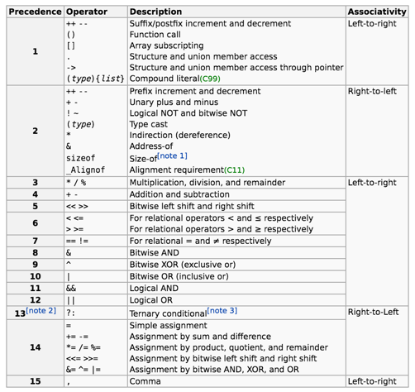
Lecture 09: Operator Precedence
Topics:
Compound Expressions
C Operator Precedence
Function Calls
Logical Operators
Application to Conditionals (if/else)
Resources:
Wiki: Order of Operations
CPP: C Operator Precedence

