Slide 1
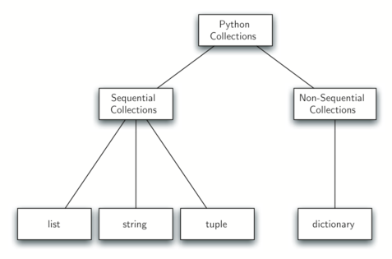
LECTURE 37: File I/O and Directory Traversal
Topics:
Opening and Reading Files
Directory Traversal
Loops and Strings Revisited
Resources:
YouTube: File I/O in Python
Rosetta: Walk A Directory
iPython: Advanced Data Types

