Slide 1
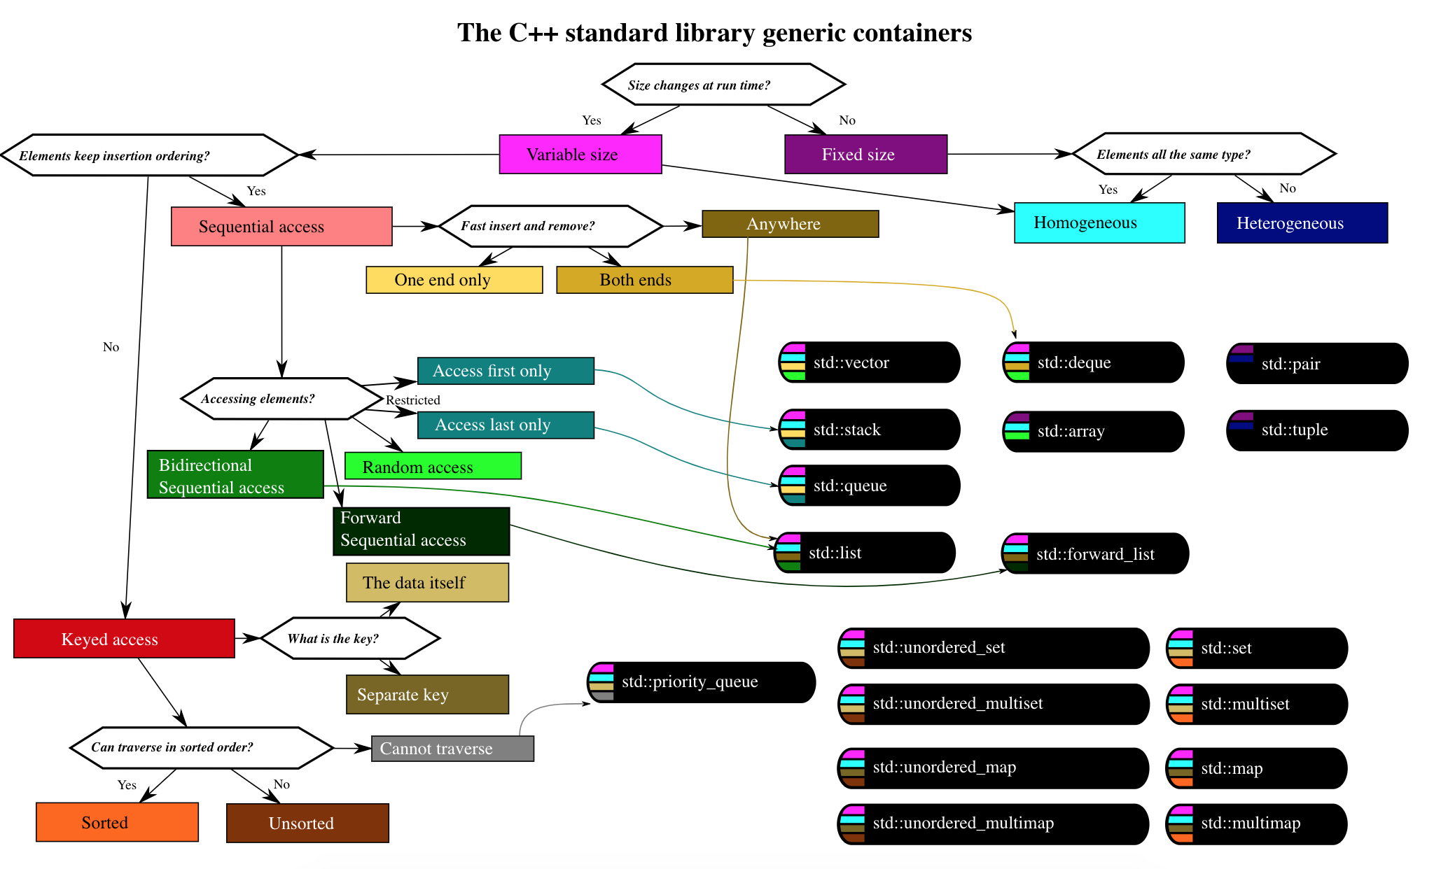
LECTURE 41: Polymorphism and Heterogeneity
Topics:
Polymorphism
Virtual Methods
Containers and Heterogeneity
Heterogenous Linked List
Python...
Resources:
TP: Polymorphism in C++
AG: A True Container in C++
GH: C Heterogenous Linked List

