Slide 1
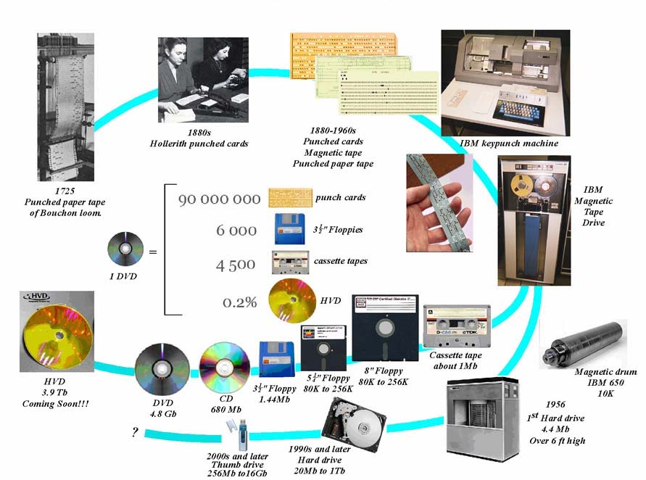
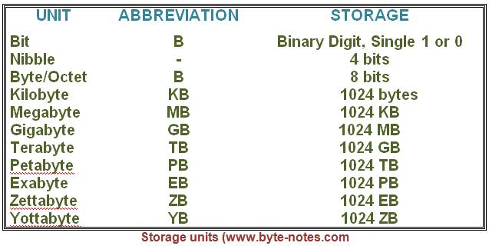
LECTURE 05: Atomic Types
Topics:
Bytes and Chars
Short and Long Integers
Floats and Doubles
Signed and Unsigned
Bits and Bytes Revisited
Resources:
K&R: Chapter 2
Wiki: ASCII
Wiki: Unicode
Wiki: IEEE Floating-Point
Wiki: Binary Coded Decimal
Branah: ASCII Conversion

