Slide 1
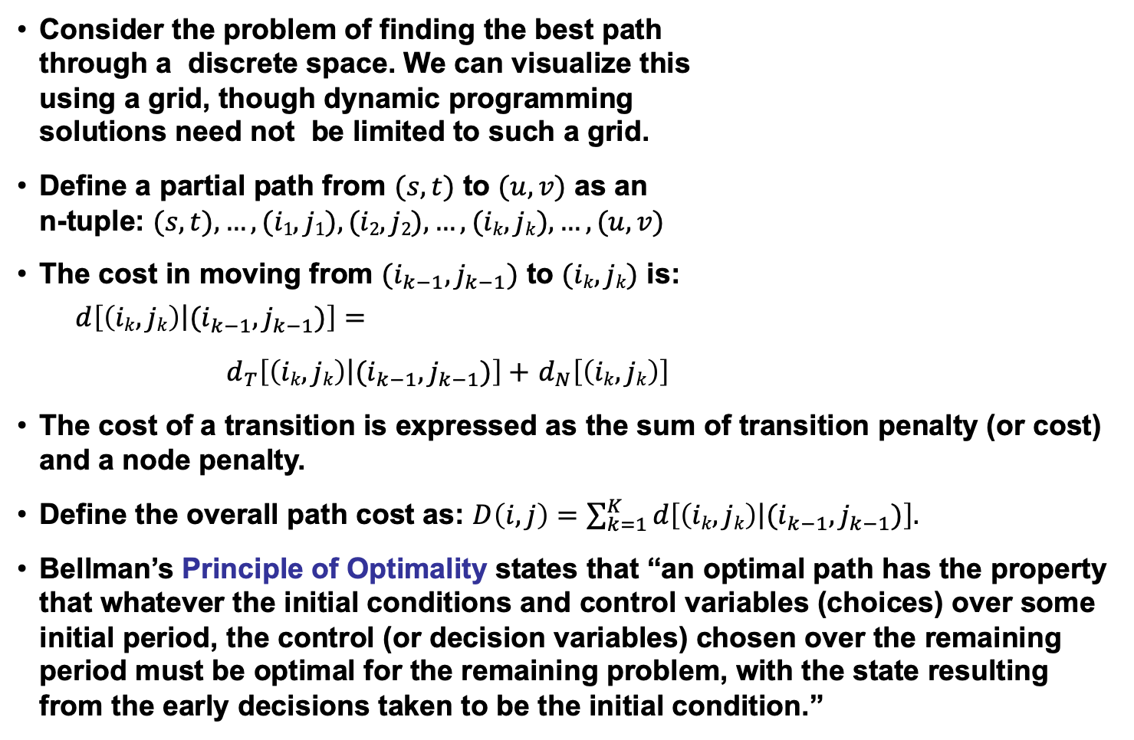
Dynamic Programming
Consider the problem of finding the best path
through a discrete space. We can visualize this
using a grid, though dynamic programming
solutions need not be limited to such a grid.
Define a partial path from $(s,t)$ to $(u,v)$ as an
n-tuple: $(s,t), …, (i1,j1), (i2,j2),…,(ik,jk),…,(u,v)$
The cost in moving from $(i_{k−1},j_{k−1})$ to $(ik,jk)$ is:
$$d\left[\left.\left(ik,jk\right)\right|(i_{k−1},j_{k−1})\right]=$$
$d_{T}\left[\left.\left(ik,jk\right)\right|(i_{k−1},j_{k−1})\right]+$ $d_{N}\left[\left(ik,jk\right)\right]$
The cost of a transition is expressed as the sum of transition penalty (or cost) and a node penalty.
Define the overall path cost as: $D\left(i,j\right)=\sum_{k=1}^{K}{d\left[\left.\left(ik,jk\right)\right|(i_{k−1},j_{k−1})\right].}$
Bellman’s Principle of Optimality states that “an optimal path has the property that whatever the initial conditions and control variables (choices) over some initial period, the control (or decision variables) chosen over the remaining period must be optimal for the remaining problem, with the state resulting from the early decisions taken to be the initial condition.”
(u,v)
(i_{k},j_{k})
(s,t)

Slide 2
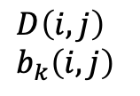
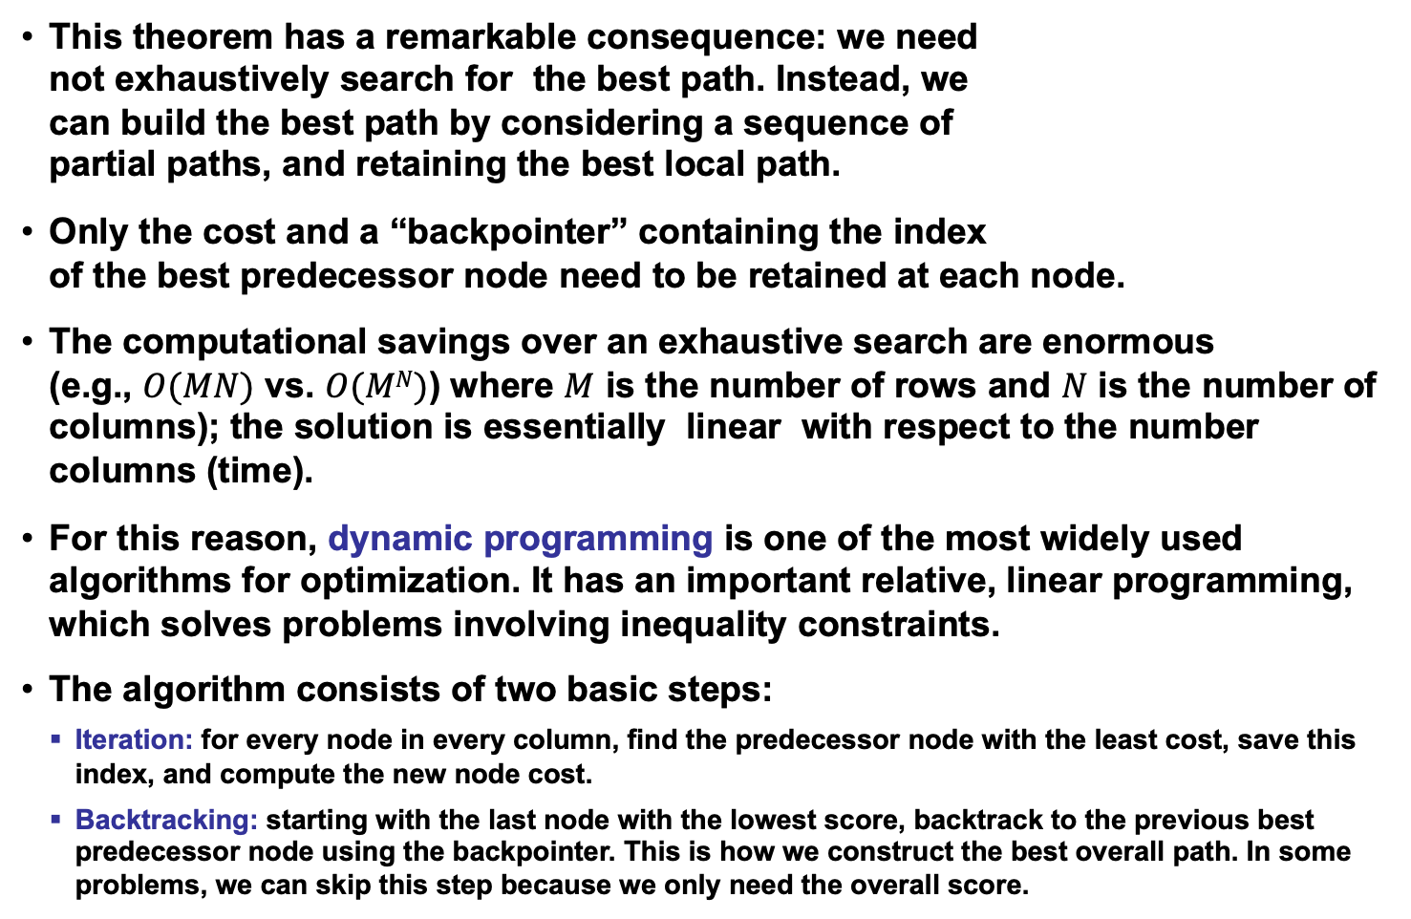
The DP Algorithm (Viterbi Decoding)
This theorem has a remarkable consequence: we need
not exhaustively search for the best path. Instead, we
can build the best path by considering a sequence of
partial paths, and retaining the best local path.
Only the cost and a “backpointer” containing the index
of the best predecessor node need to be retained at each node.
The computational savings over an exhaustive search are enormous
(e.g., $O(MN)$ vs. $O(MN)$) where $M$ is the number of rows and $N$ is the number of columns); the solution is essentially linear with respect to the number columns (time).
For this reason, dynamic programming is one of the most widely used algorithms for optimization. It has an important relative, linear programming, which solves problems involving inequality constraints.
The algorithm consists of two basic steps:
  Iteration: for every node in every column, find the predecessor node with the least cost, save this index, and compute the new node cost.
  Backtracking: starting with the last node with the lowest score, backtrack to the previous best predecessor node using the backpointer. This is how we construct the best overall path. In some problems, we can skip this step because we only need the overall score.
$$D\left(i,j\right) \\ b_{k}\left(i,j\right)$$

Slide 3
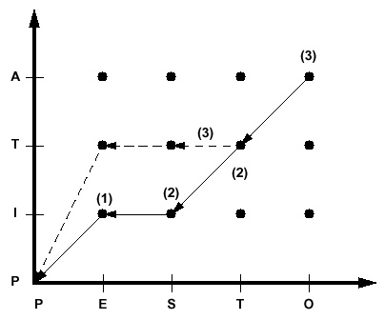
Example
Dynamic programming is best illustrated with a string-matching example.
Consider the problem of finding the similarity between two words: Pesto and Pita. An intuitive approach would be to align the strings and count the number
of misspelled letters:
Reference: P I ** t a
Hypothesis: P e s t o
If each mismatched letter costs 1 unit, the
overall similarity would be 3.
Let us define a cost function:
  Transition penalty: a non-diagonal transition incurs
  a penalty of 1 unit.
  Node penalty: Any two dissimilar letters that are
  matched at a node incur a penalty of 1 unit.
Let us use a “fixed-endpoint” approach,
which constrains the solution to begin
an the origin and end by matching the
last two letters (“a” and “o”).
Note that this simple approach does not allow for some common phenomena in spell-checking, such as transposition of letters.

Slide 4
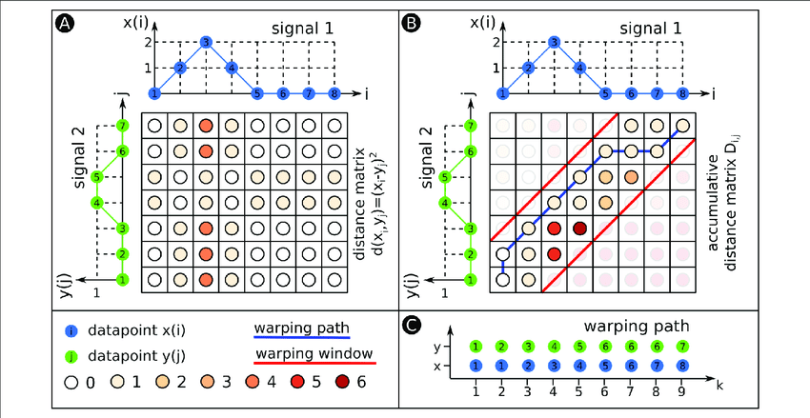
Discussion
Bellman’s Principle of Optimality and the resulting algorithm we described require the cost function to obey certain well-known properties (e.g., the node cost cannot be dependent on future events).
Though this might seem like a serious constraint, the algorithm has been successfully applied to many graph search problems, and is still used today because of its efficiency.
It is very important to remember that a DP solution is only as good as the cost function that is defined. Different cost functions will produce different results.
Engineering the cost function is an important part of the technology development process.
When applied to time alignment
of time series, dynamic
programming (DP) is often
referred to as dynamic time
warping (DTW) because it
produces a piecewise linear, or
nonuniform, time scale
modification between the two
signals.

Slide 5
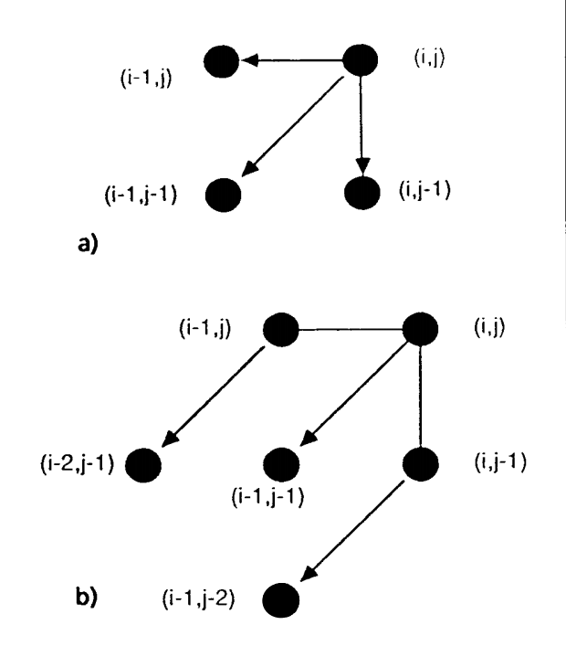
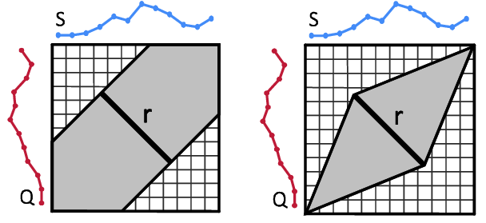
Variants of DTW: Slope Constraints and Free Endpoints
In some applications (such as time series analysis),
it is desirable to limit the maximum slope of the best
path (e.g., limit the playback speed of a voice mail to
a range of [1/2x,2x].
This can reduce the overall computational
complexity with only a modest increase in the
per-node processing.
This can be achieved by implementing different
slope constraints.
In other applications, such as word spotting, it is
advantageous to allow the endpoints to vary.
This is a special case of general
optimization theory.
The best path need not start
at the lower left or terminate
in the upper right of the DP grid.
HMMs provide a much better
means of achieving this.

Slide 6
Application: Scoring of Sequential Decoding Systems
String Matching: binary similarity measure, equal weighting of error types
Ref: bckg seiz SEIZ SEIZ bckg seiz bckg
Hyp: bckg seiz BCKG **** bckg seiz ****
(Hits: 4 Sub: 1 Ins: 0 Del: 2 Total Errors: 3)
Ref: bckg seiz BCKG **** bckg seiz ****
Hyp: bckg seiz SEIZ SEIZ bckg seiz bckg
(Hits: 4 Sub: 1 Ins: 2 Del: 0 Total Errors: 3)
Phonetic String Alignment: using a more sophisticated distance measure based on phonetic similarity
Ref: CUT TALL SPRUCE TREES
Hyp: HAUL MOOSE FOR FREE
Rph: K AX T T ae ** l S P R Y uw s ** ** ** ** T r iy S
Hph: ** ** ** HH ae AX l ** ** M ** uw s F OW R ** F r iy **
(Hits: 9 Sub: 3 Ins: 2 Del: 6 Total Errors: 11)
Ref: CUT TALL SPRUCE *** TREES
Hyp: *** HAUL MOOSE FOR FREE
(Hits: 0 Sub: 3 Ins: 1 Del: 1 Total Errors: 5)

Slide 7
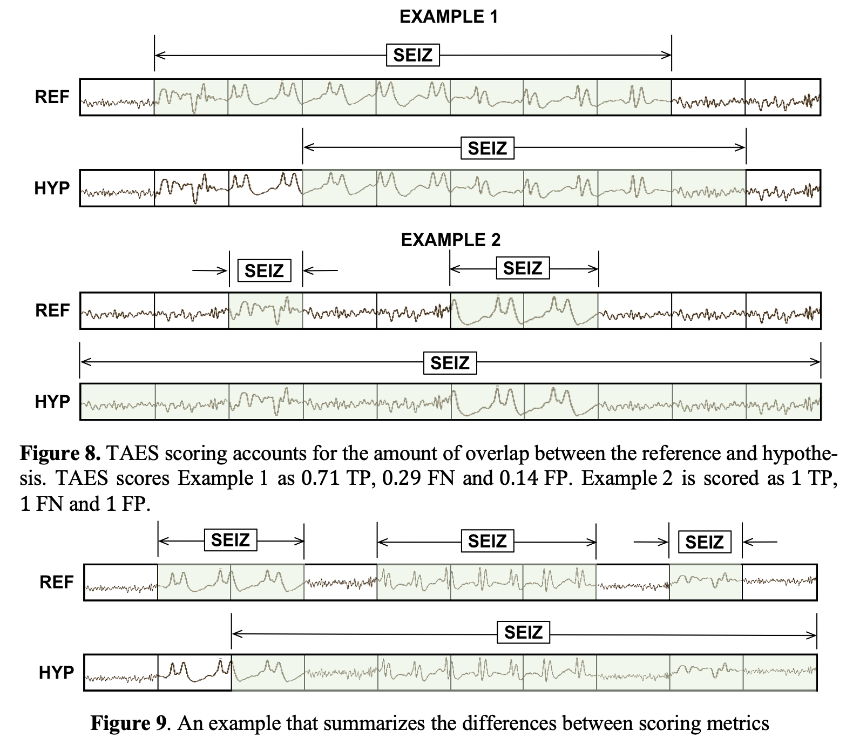
Application: Scoring of Sequential Decoding Systems

