Slide 1
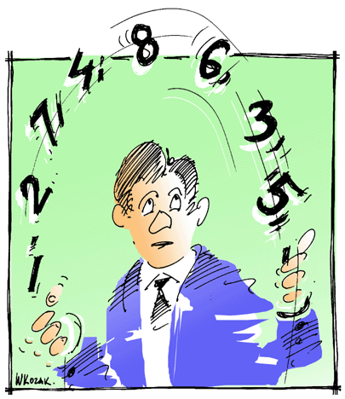
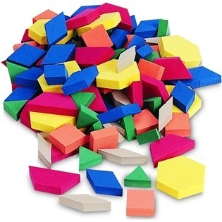
LECTURE 20: ESTIMATING, COMPARING AND COMBINING CLASSIFIERS
Objectives: Bagging and Boosting Cross-Validation ML and Bayesian Model Comparison Combining Classifiers
Resources: MN: Bagging and Decision Trees DO: Boosting WIKI: AdaBoost AM: Cross-Validation CV: Bayesian Model Averaging VISP: Classifier Combination
• URL: .../publications/courses/ece_8443/lectures/current/lecture_20.ppt
Notes:
MS Equation 3.0 was used with settings of: 18, 12, 8, 18, 12.

Slide 2
Bagging
Previously we addressed the use of resampling in estimating statistics, such as parameters of models.
Next, we consider resampling methods that can be used directly in the process of training a classifier.
The general term arcing – adaptive reweighting and combining, refers to a class of methods that deal with reusing or selecting data in order to improve classification.
Bagging, or bootstrap aggregation, uses multiple versions of the training set, each created by drawing n’ < n samples from D with replacement.
Each set is used to train a classifier and the final decision is based on a vote of each component of the classifier.
Typically the component classifiers are of the same general form (e.g., HMMs).
A classifier/learning algorithm is considered unstable if small changes in the training data lead to large changes in accuracy.
Decision trees, for example, can be unstable.
Bagging, in general, improves stability because it effectively averages out such anomalous behavior by pooling classifiers.
The voting algorithm can be simple, such as a majority vote, or as we will see later, can use more sophisticated statistical methods.

Slide 3
Boosting
Goal: Similar to bagging, improve the accuracy of a learning algorithm by forming an ensemble of component classifiers.
Consider creating a three component classifier for a two-category problem:
Randomly select a set of n₁ < n patterns, called D₁, from the full training set.
Train a classifier C₁ on this set.
Note: For boosting to provide a significant benefit, C₁ need only be a weak learner, which means it has an accuracy slightly greater than chance.
Create a training set, D₂, that is “most informative” given component classifier C₁:
Most informative: half the patterns should be correctly classified by C₁ .
Search the remaining (n-n₁) patterns for this data.
Train a second classifier, C₂, on this new data set D₂.
To build a third training set, D₂ , choose patterns for which C₁ and C₂ disagree. Train a third classifier, C₃, on this data.
Final classification can be performed using a majority vote of C₁, C₂, and C₃.
Benefits: high performance; Drawbacks: computational cost.
Issues: size of the partitions (initial guess: n₁ ≅ n₂ ≅ n₃ ≅ n/3).

Slide 4
AdaBoost
Adaptive Boosting (AdaBoost) is a popular variant on boosting that allows the designer to continue adding weak learners until some desired performance criterion is met.
Each training pattern receives a weight that determines its probability of being selected for a training set for an individual component classifier.
Initialize the weights of the training patterns to be equal (uninformative prior).
If the training pattern is accurately classified, then that pattern’s chance of being used again is decreased (no longer an informative pattern):
On iteration k, draw a training set at random according to the current training data weight distribution;
Train classifier C_{k};
Increase weights of patterns misclassified by C_{k} (decrease weights for correctly classified patterns);
Final classification is based on a discriminant function:
where

Slide 5
Learning With Queries
In previous sections, we assumed a set of labeled training patterns and employed resampling methods to improve classification.
When no labels are available, or the cost of generating truth-marked data is high, how can we decide what is the next best pattern(s) to be truth-marked and added to the training database?
The solution to this problem goes by many names including active learning (maximizing the impact of each new data point) and cost-based learning (simultaneously minimizing classifier error rate and data collection cost).
Two heuristic approaches to learning with queries:
Confidence-based: select a data point for which the two largest discriminant functions have nearly the same value.
Voting-based: choose the pattern that yields the greatest disagreement among the k component classifiers.
Note that such approaches tend to ignore priors and attempt to focus on patterns near the decision boundary surface.
The cost of collecting and truth-marking large amounts of data is almost always prohibitively high, and hence strategies to intelligently create training data are extremely important to any pattern recognition problem.

Slide 6
Cross-Validation
In simple validation, we randomly split the set of labeled training data into a training set and a held-out set.
The held-out set is used to estimate the generalization error.
M-fold Cross-validation:
The training set is divided into n/m disjoint sets, where n is the total number of patterns and m is set heuristically.
The classifier is trained m times, each time with a different held-out set as a validation set.
The estimated performance is the mean of these m error rates.
Such techniques can be applied to any learning algorithm.
Key parameters, such as model size or complexity, can be optimized based on the M-fold Cross-validation mean error rate.
How much data should be held out? It depends on the application, but 80% training / 10% development test set / 10% evaluation (or less) is not uncommon. Training sets are often too large to do M-fold Cross-validation.
Anti-cross-validation as also been used: adjusting parameters until the first local maximum is observed.

Slide 7
Jackknife and Bootstrap
Methods closely related to cross-validation are the jackknife and bootstrap estimation procedures.
Jackknife: train the classifier n separate times, each time deleting a single point. Test on the single deleted point. The jackknife estimate of the accuracy is the mean of these “leave-one-out” accuracies. Unfortunately, complexity is very high.
Bootstrap: train B classifiers each with a different bootstrap data set, and test on the other bootstrap data sets. The bootstrap estimate of the classifier accuracy is the mean of these bootstrap accuracies.

Slide 8
ML-Based Model Comparison
Maximum likelihood model comparison is a direct generalization of the ML parameter estimation process.
Let h_{i} ∈ H represent a candidate hypothesis or model and let D represent the training data. The posterior probability if any given model is:
where we can ignore the normalizing factor (the denominator).
The first factor is the evidence for h_{i}, while the second factor Is our subjective prior over the space of hypotheses.
If we neglect the second term, we have a maximum likelihood solution.
In ML model comparison, we find the ML parameters for each of the candidate models, calculate the resulting likelihoods, and select the model with the largest such likelihood.
We can also use this formulation to compare models such as HMM models directly by applying the means of one model to the other model. This is often a convenient way to compute similarities without reverting back to the original training data set.

Slide 9
Bayesian Model Comparison
Bayesian model comparison uses the full information over priors:
It is common for the posterior to be peaked at , and thus the evidence integral can be approximated as:
The first term can be described as the best-fit likelihood.
The second term is referred to as the Occam factor and is the ratio of the volume that can account for the data by the prior volume without regard for D. This factor has a magnitude less than one.
If we assume the posterior is a Gaussian, then the posterior can be calculated directly as:
where H is a Hessian matrix:
Note that the data need not be Gaussian, just the evidence distribution. This is a reasonable assumption based on the Law of Large Numbers.

Slide 10
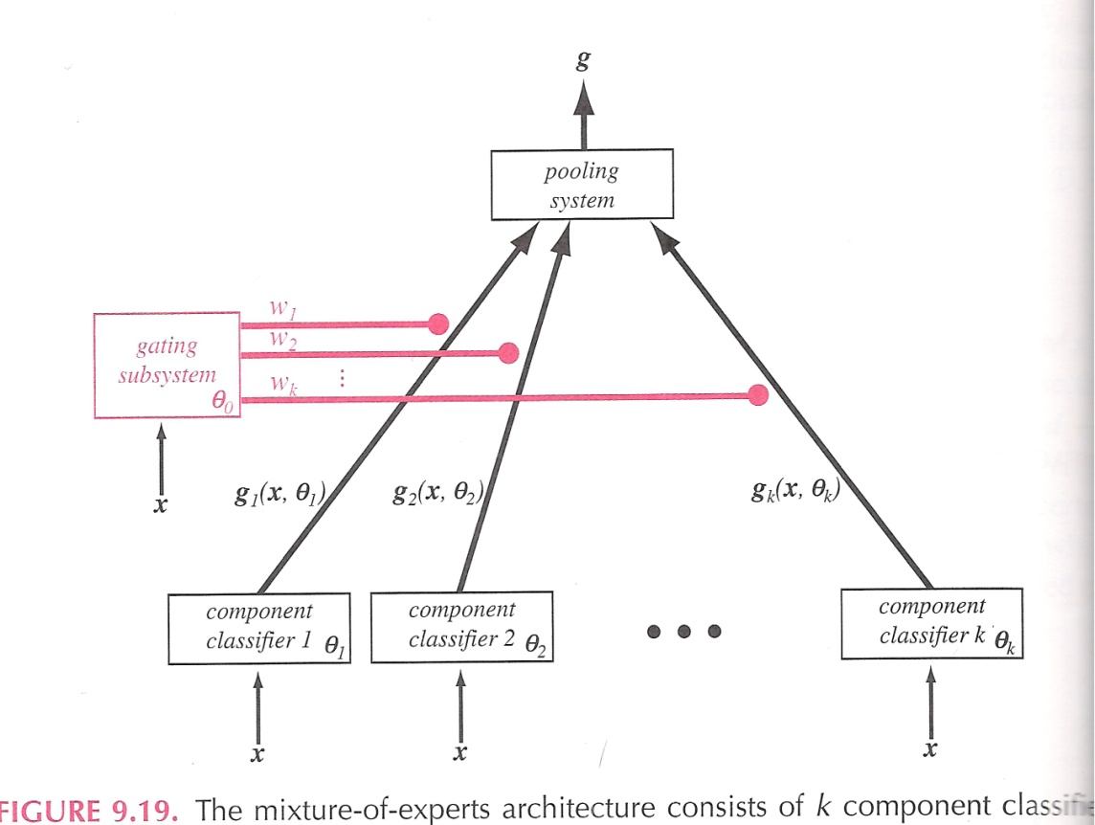
Combining Classifiers
We have already seen several classifiers whose decision is based on the outputs of component classifiers. These are more generally known as a mixture of experts model.
We assume each pattern can be modeled by a mixture distribution:
where represents the vector of all relevant parameters.
We have seen this before in the form of a mixture distribution that models state outputs in an HMM.
The weights are constrained to sum to 1: .
The conditional mean of the mixture density is:

Slide 11
Mixture of Experts
The goal in estimating the parameters of the gating system is to maximize the log-likelihood of the training data:
A straightforward approach is to use gradient descent (why?):
and
Note that is the prior probability that the process r is chosen given the input is x^{i}.
EM can also be used to estimate the mixture coefficients and is generally preferred today.
The final decision rule is to choose the category corresponding to the maximum discriminant value after pooling. An alternative is the winner-take-all method: choose the single component classifier with the highest confidence.
The number of mixture components is typically found experimentally.

Slide 12
Summary
Introduce several approaches to improving classifier performance:
Bagging (bootstrap aggregation): uses multiple versions of the training set, each created by drawing n’ < n samples from D with replacement. …
Boosting: training component classifiers on “most informative” subsets.
AdaBoost (Adaptive Boosting): iteratively weight each training pattern while boosting.
Learning from Queries: select the most informative new training pattern so that accuracy and cost can be simultaneously optimized.
Introduced new ways to estimate accuracy and generalization:
M-Fold Cross-validation: estimating the error rate as the mean across various subsets of the data.
Jackknife and Bootstrap: alternate ways to repartition the training data to estimate error rates.
Model comparison using maximum likelihood and Bayesian approaches.
Classifier combination using mixture of experts.
Next: a closer look at reinforcement learning, a class of methods that includes learning from queries and active learning.

