Slide 1
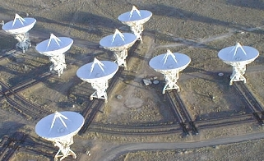
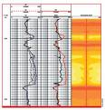
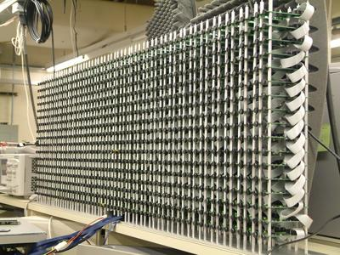
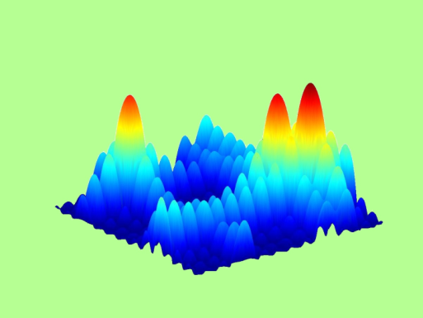
LECTURE 13: ARRAY SIGNAL PROCESSING
Objectives: Introduction SNR Gain Patterns Beam Steering Shading
Resources: Wiki: Array Processing Wiki: Beamforming BEvans: Spatial Arrays AG: Beamforming
• URL: .../publications/courses/ece_8423/lectures/current/lecture_13.ppt
• MP3: .../publications/courses/ece_8423/lectures/current/lecture_13.mp3

Slide 2
Introduction
Array processing deals with applying signal processing techniques to a spatially distributed group of sensors.
The potential lies in achieving improvements in the SNR.
The spatial dimensions introduces the possibility of directional discrimination between the signal and the interference (e.g., noise).
The measured signals are often electromagnetic (e.g., deep space radio telescopes, radar) or acoustic (e.g., auditoriums, automobiles).
The arrays can be arranged in a number of topologies (1D, 2D, and even 3D).
Often, achieving an improvement in the SNR involves detecting and tracking the direction of the signal.
This is achieved by independent adjustment of the time delays associated with each sensor. The analysis is completely analogous to that for phased antenna arrays.
Adaptive signal processing is used to estimate and optimize the weights and delays associated with the sensors.
One big advantage of the “electronic approach” is the ability to track multiple targets from the same, fixed array (formerly done via rotating antennae).

Slide 3
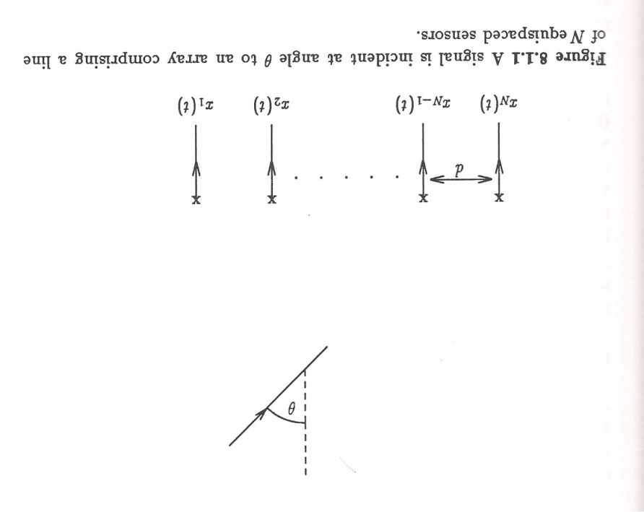
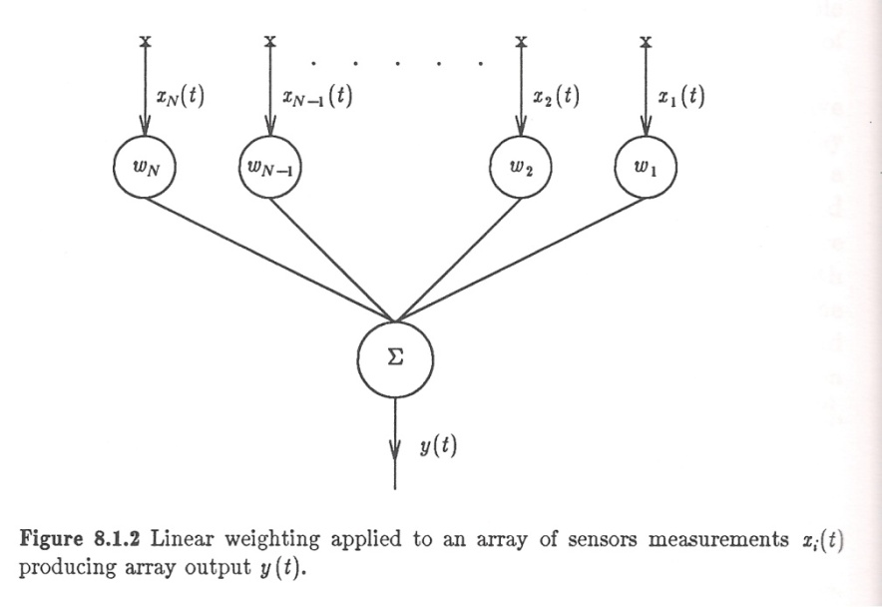
Basic Array Properties
We will focus on arrays where the sensors are uniformly spaced.
Other configurations and spacing can be dealt with using an analysis that parallels sampling theory.
The output of the array is a linear combination of the inputs:
(The weights can be complex.)
Assume the transmission path is linear and time-invariant:
h_{j}(t) represents the transfer function from the source to the sensor. It can be simple, such as a time delay dependent on the distance:
Denote interference as u(t) and noise as v(t).

Slide 4
SNR Gain By Summation
Suppose the signal is incident at broadside (θ = 0°) with w_{i} = 1.
Assume each measurement is corrupted by v_{i}(t) which is uncorrelated from sensor to sensor:
The input SNR may be defined by:
The array output is:
The output SNR is:
The gain in SNR (an upper bound) is linearly proportional to the number of sensors:

Slide 5
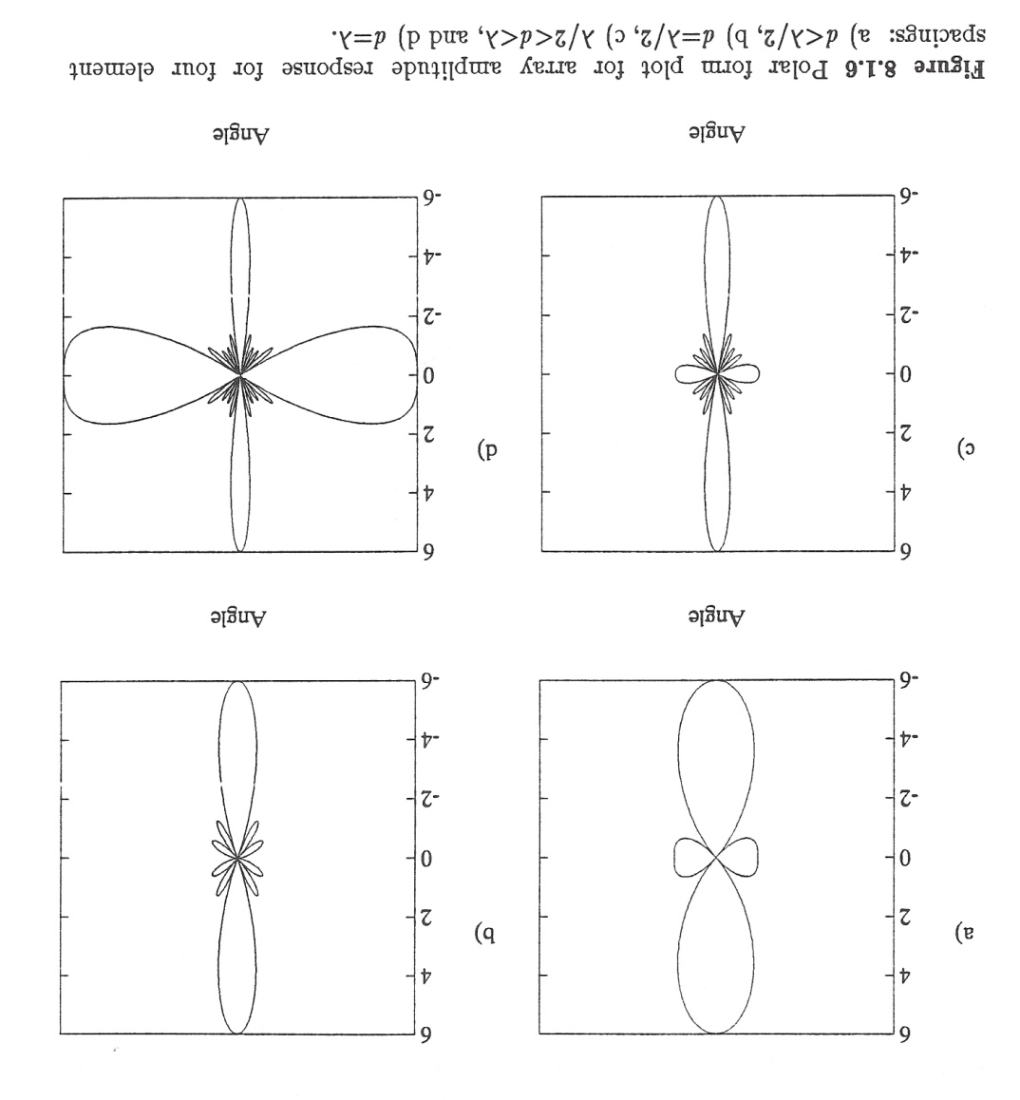
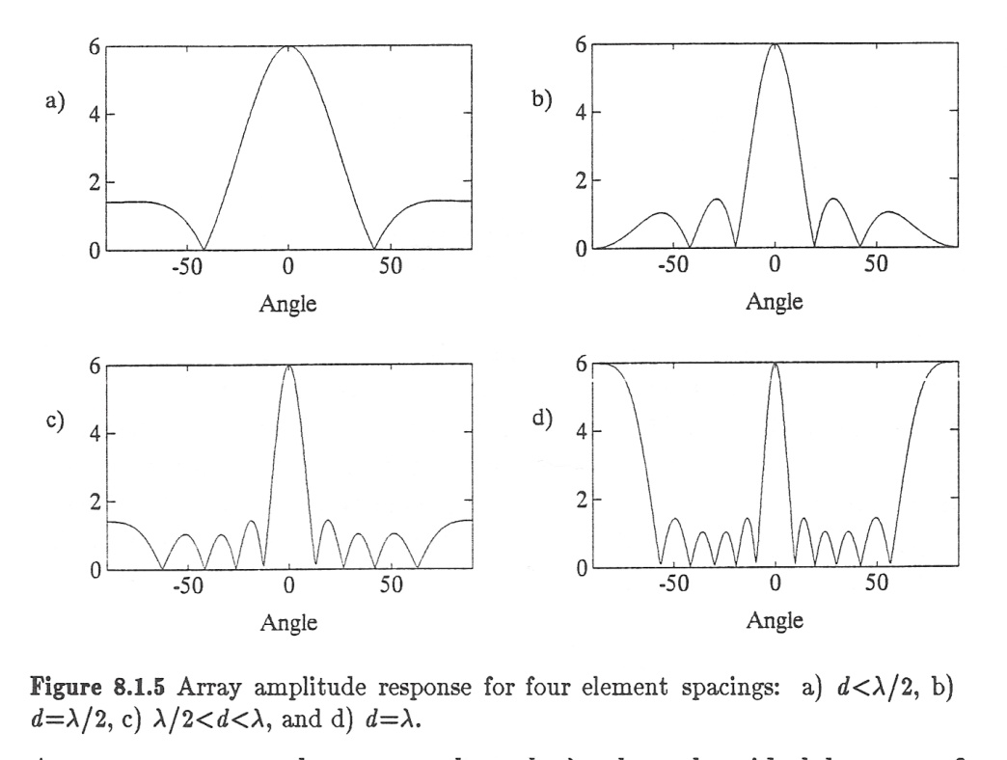
Sensitivity Patterns For A 2-Sensor Array
The sensitivity of the array can be show to be a function of the incident angle of the plane wave.

Slide 6
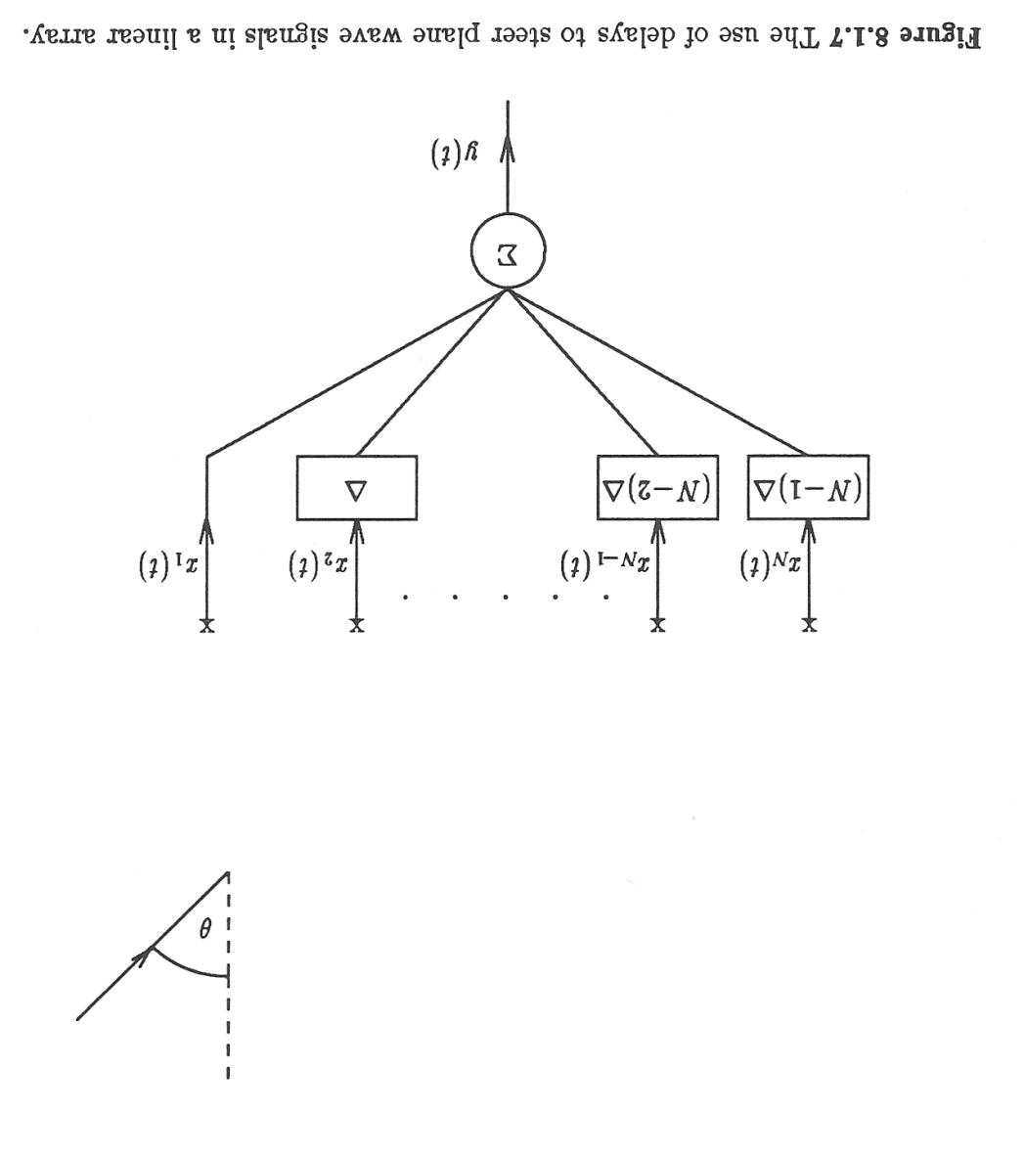
Beam Steering
Beam steering is the process of rotating the main lobe of the array pattern in the direction of the incoming signal.
This is done by simply delaying each sensor by an amount proportional to the time it takes for the signal to propagate a distance equal to the sensor spacing.
The angle of the main lobe obeys a simple relation:
The process of steering the beam using time delay and summing the signals is known as the delay and sum beamformer.
Note that this delay can be done digitally as part of the beam steering algorithm. Also, multiple beams can be managed simultaneously.

Slide 7
Array Shading (Deterministic)
Given N sensors, we can weight the sensor outputs to steer the array in the direction of a signal, AND to steer nulls in the direction of noise.
We will first explore a deterministic way of doing this using a priori information, and then later in this chapter explore ways to do this adaptively.
Define a narrowband signal:
where m(t) is an amplitude modulation which is considered slowly varying so that it can be assumed to be constant across the array.
Define a steering vector, s, associated with an angle θ:
where d is the sensor spacing, and k = ω/c.
Define a vector of measurements as:
For M separate sources:

Slide 8
Optimizing Weights
We can define an NxM matrix, Q, consisting of the steering vectors, and a vector of the modulated signals:
We can define a weight vector that we will use to steer the array:
We can apply a gain, g, to a signal from direction θ :
For M sources, we can have M distinct gains:
Assuming the signal is associated with the first sensor, we can steer nulls in the other directions by solving:
or, equivalently solving the matrix equation:
If the number of sources equals the number of sensors, Q is square, and we can solve this set. If the number of sources is less than the number of sensors, we need to add extra constraints.

Slide 9
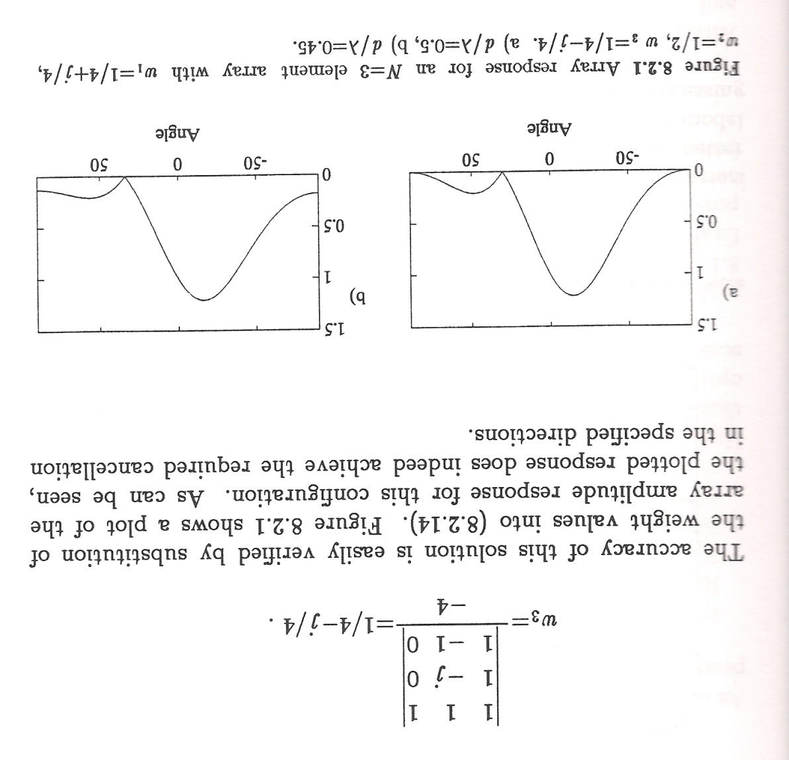
Example

Slide 10
Summary
Introduced array signal processing.
Demonstrated an upper bound on the gain that can be achieved.
Discussed basic properties of the array.
Derived a way to improve performance by steering the array in the direction of the signal and steering nulls in the direction of the interference.
Next: demonstrate how to do this adaptively.
Advantages:
No requirement on a priori information about the signal or interference.
Adapt to changes in the signal or the interference.
Adapt to noise.
Track multiple signals simultaneously.

