Slide 1
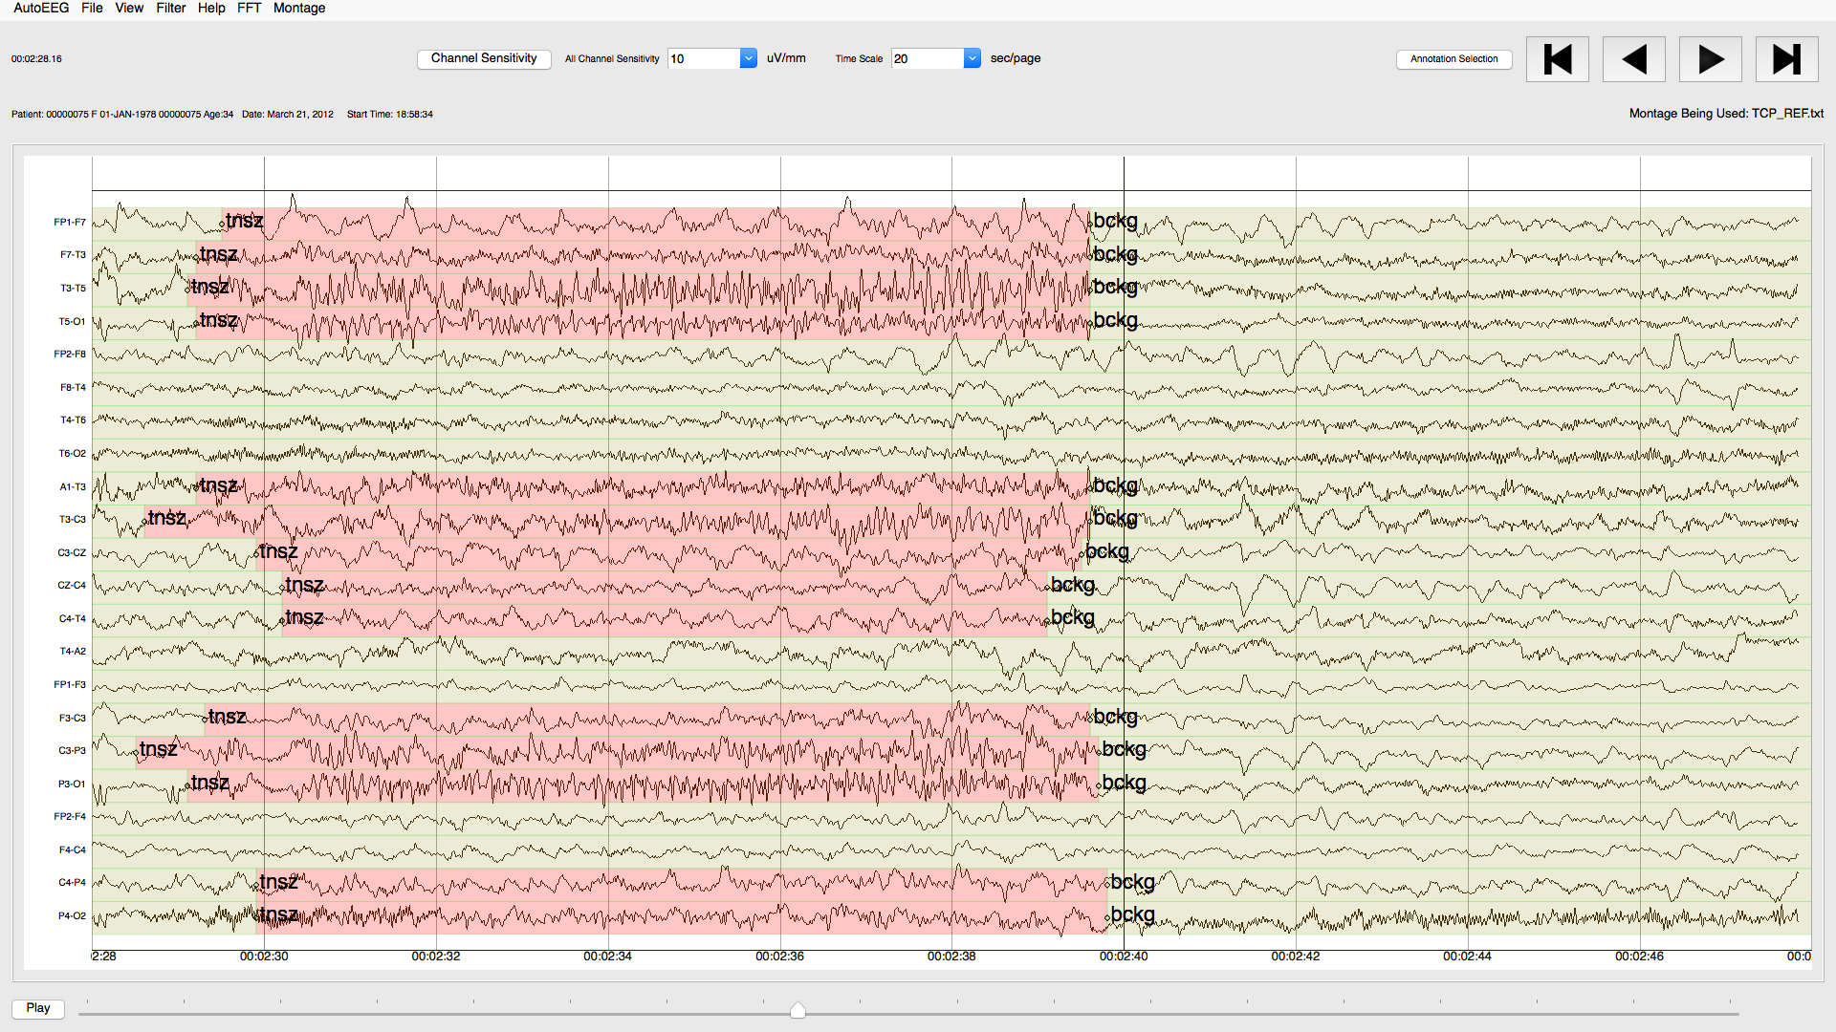
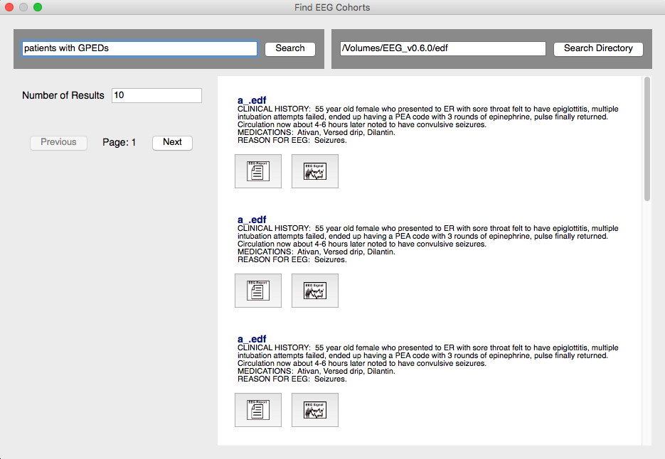
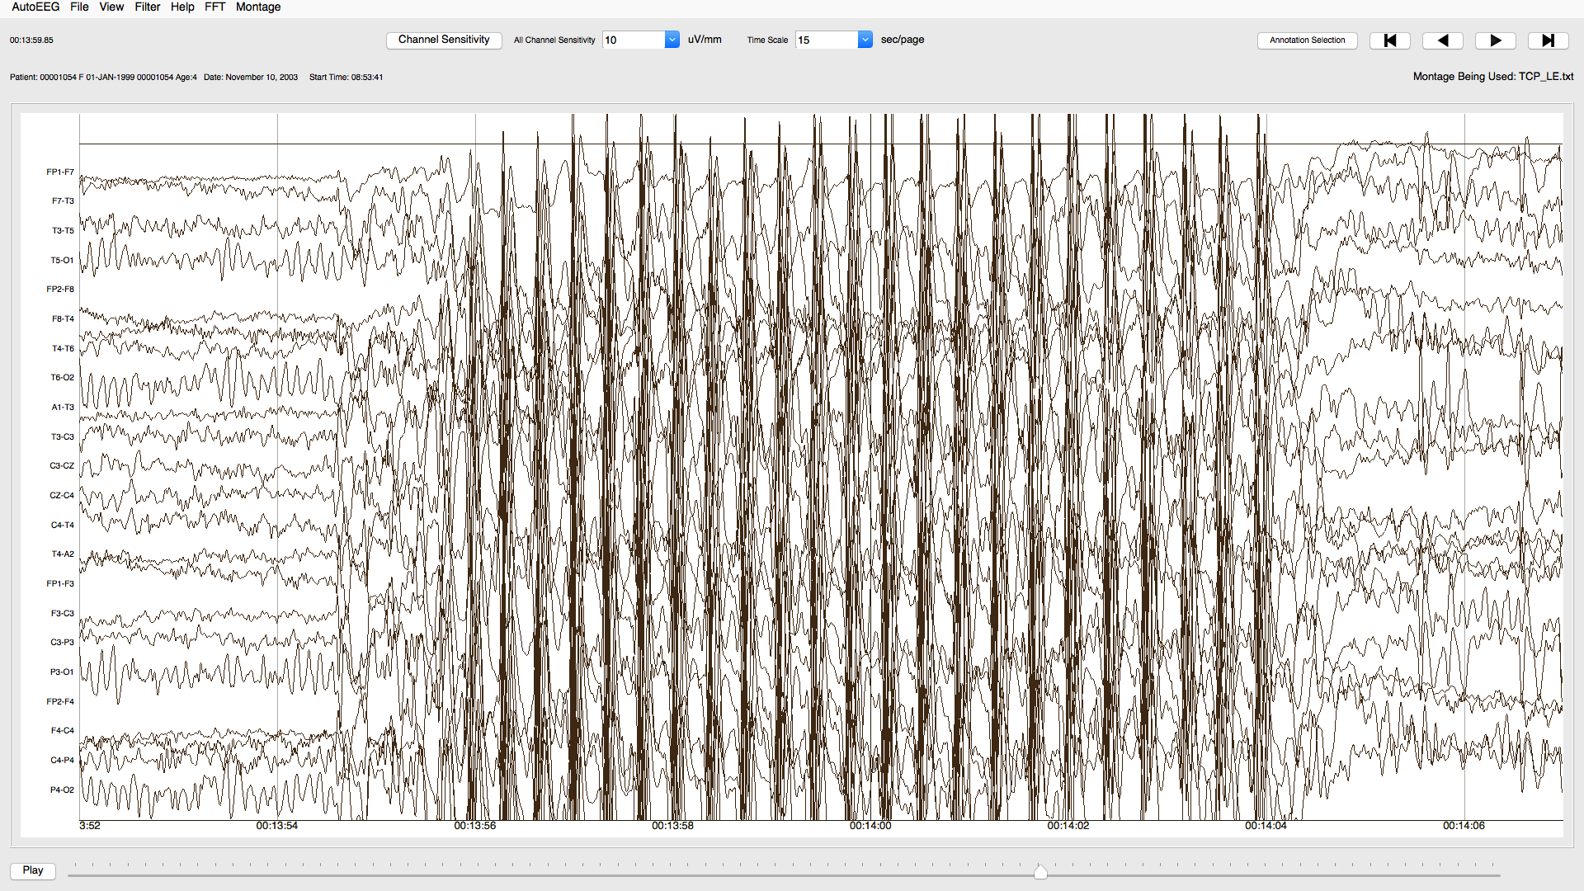
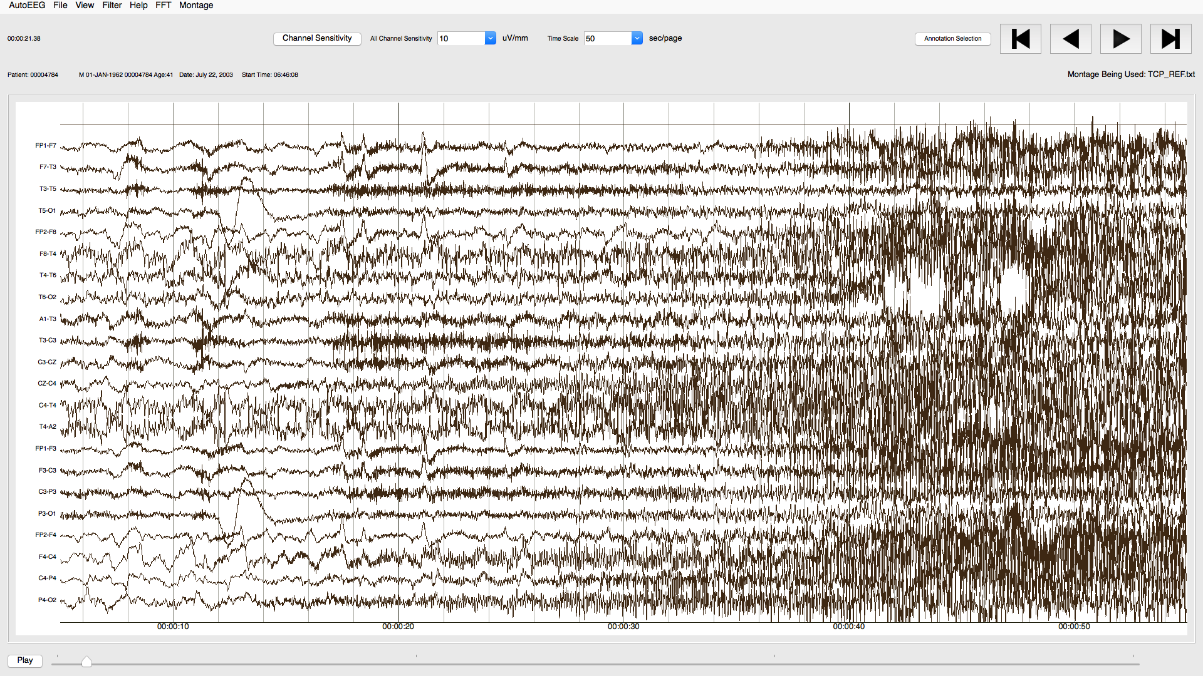
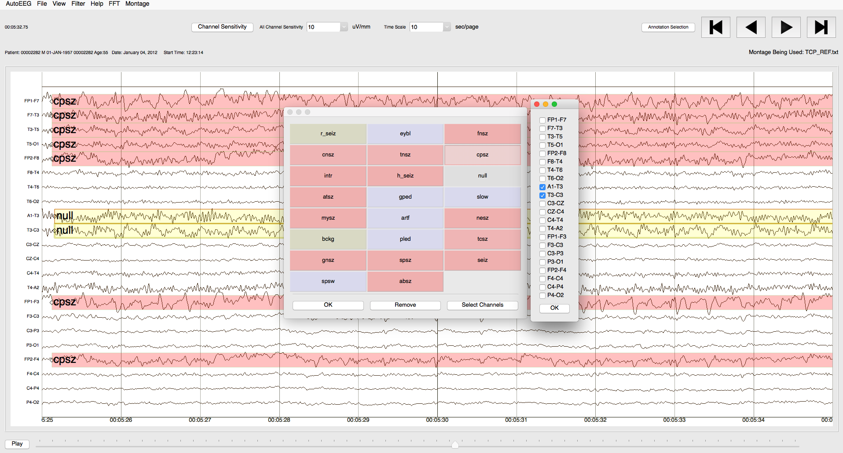
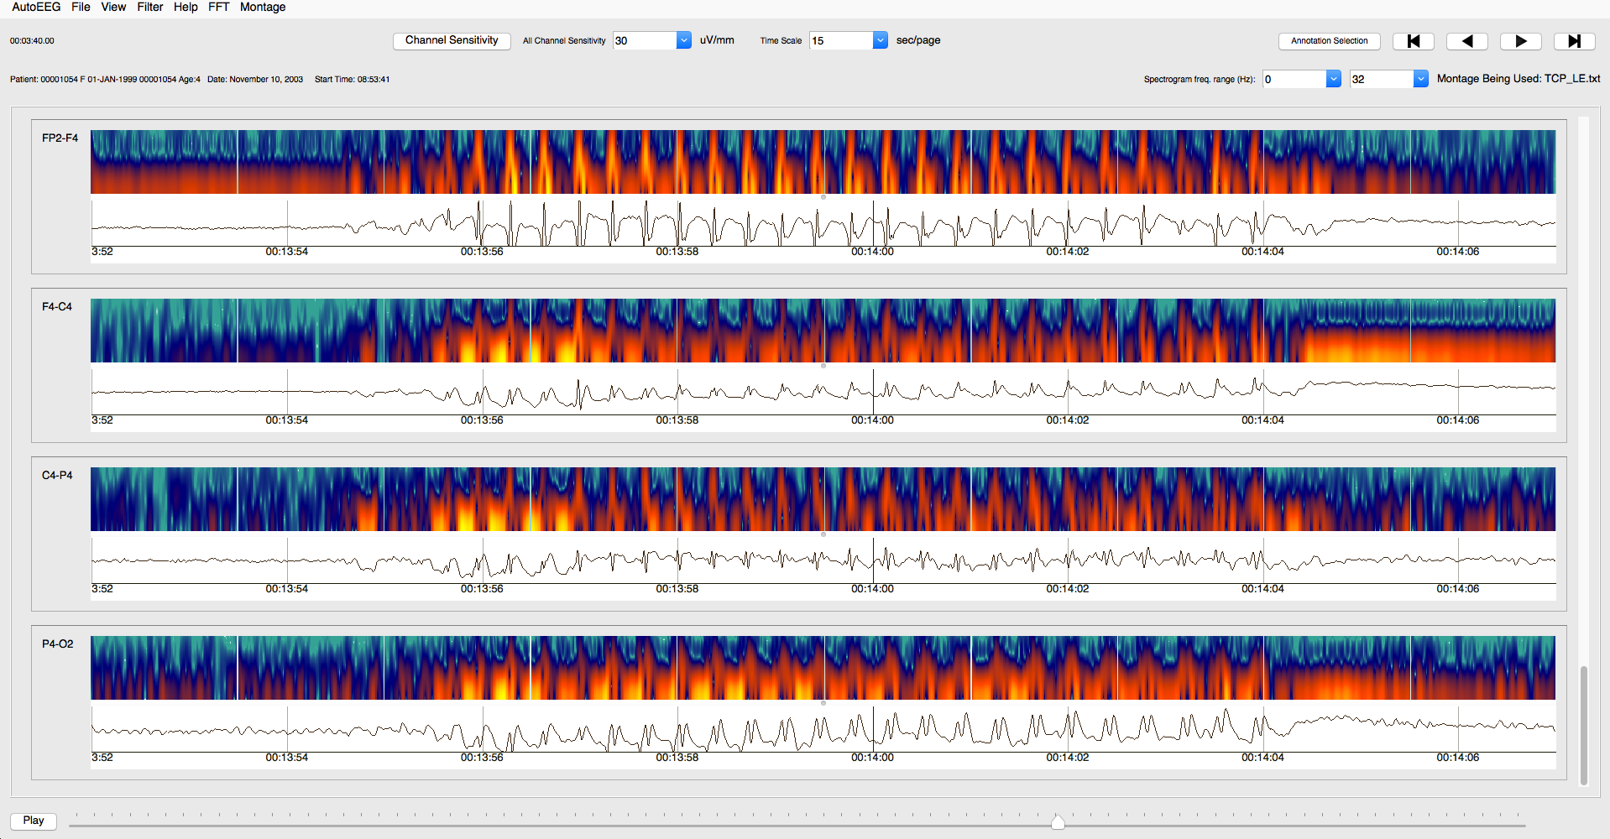
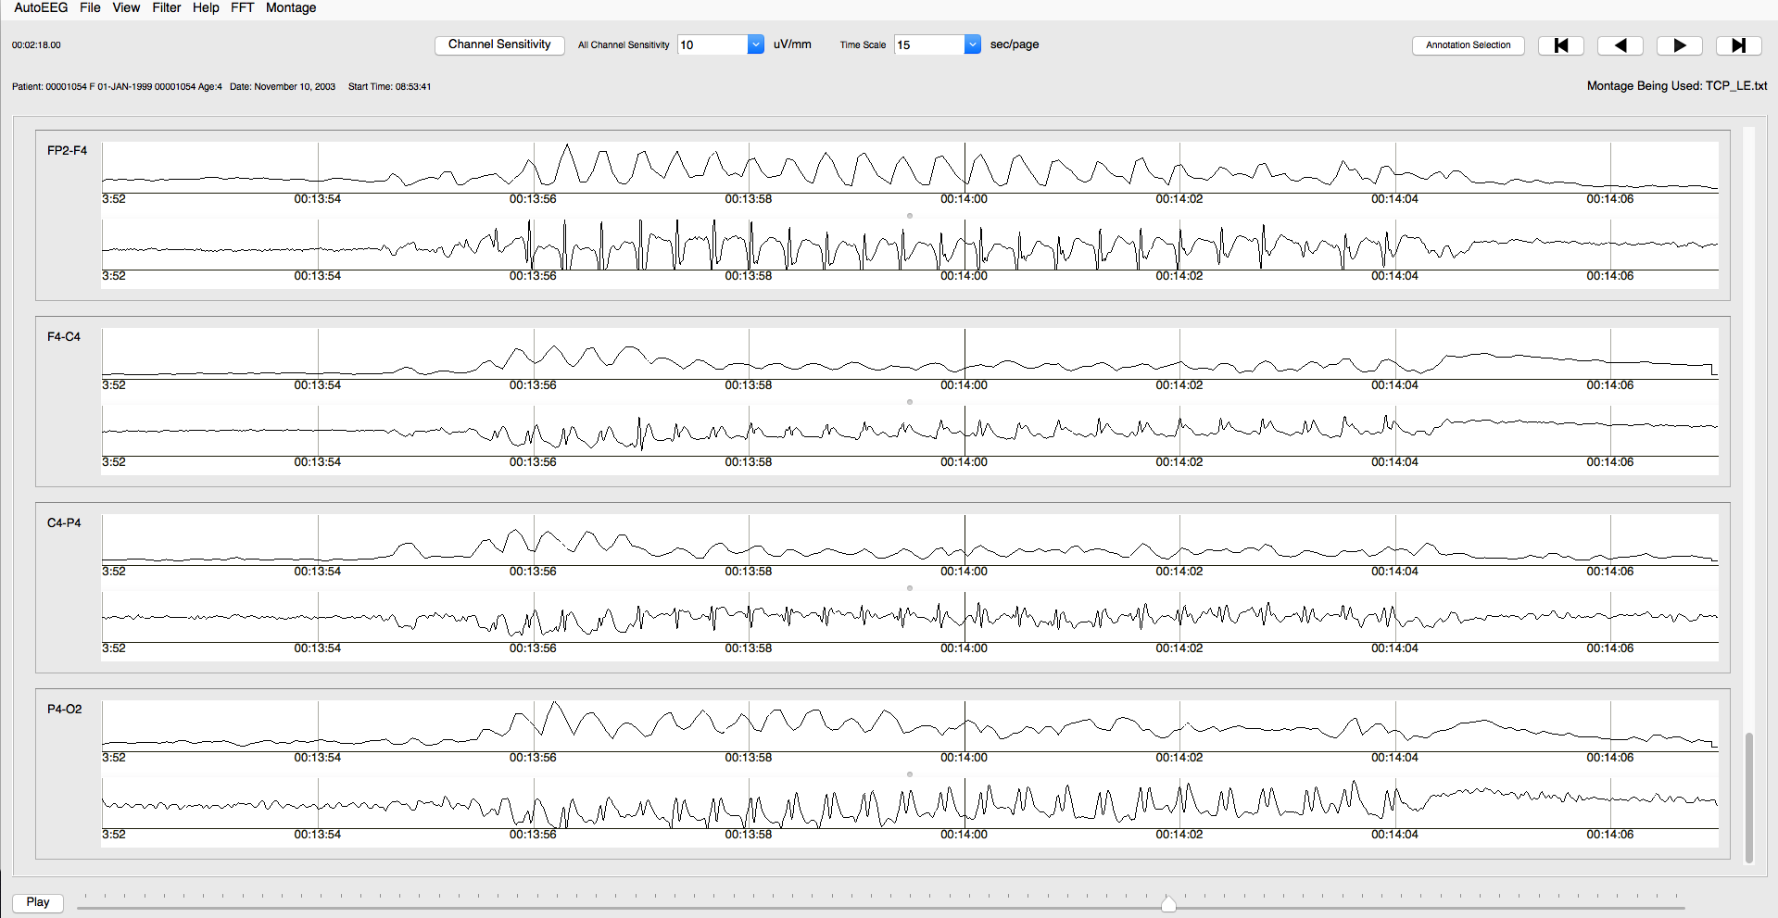
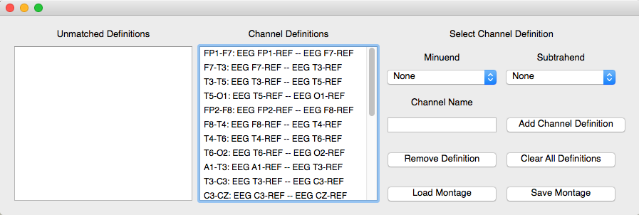
Facilitating the Annotation of Seizure Events Through An Extensible Visualization Tool
N. Capp, E. Krome, I. Obeid and J. Picone
The Neural Engineering Data Consortium, Temple University
College of Engineering
Temple University
www.nedcdata.org
Abstract
An electroencephalogram (EEG) is a multi-channel signal which describes the electrical activity in the brain through electrodes placed on the scalp.
Other EEG visualization tools do not allow users to annotate directly over their signal displays. Similarly, it is difficult to add new visualizations to these tools.
This visualization tool allows users to create annotations through the interaction of context menus and click and drag actions.
A search API has been integrated to this viewer. Users can query the TUH EEG Corpus for reports and EEG signals.
The features within the viewer are customizable through a preferences window, allowing users to save settings based on their annotation and visualization needs.
This visualization tool is written in PyQt, which allows for Graphical User Interface programming that is supported across multiple platforms.
Facilitating EEG Annotation
The visualization tool provides an interface to view, create, and edit annotations directly over the EEG signal.
Annotations are colored overlays containing a label defining the event type. These events include various seizures, artifacts, and other markings used for our research.
An annotation is created independently of the other channels, allowing for the precise annotating of boundaries and event types.
The tool utilizes annotation navigation buttons to easily scroll through the EEG to find regions of interest.
Creating annotations is accomplished through selecting channels and the annotation label via a windowed interface.
Increasing Visibility
The ability to change the timescale of the plotting window from the traditional 10 seconds allows for users to more easily visualize and annotate events on a single window.
Channels suffering from heavy lead artifact or containing electrocardiogram (EKG) signals often clutter the plotting visualization. A per-channel gain setting is utilized to increase the visibility of events during such cases.
A customizable filter is also integrated into signal plotting, allowing the user to remove various frequency ranges and bands. This filter includes various bandpass presets to, for example, only show frequencies in the alpha or theta bands. A common use of this filter is to apply a band-reject filter to remove the 60Hz hum from the EEG signal.
Alternate Visualizations
The visualization tool currently supports three visualizations: Waveform (default), Spectrogram, and Energy.
The Waveform view is the format through which professional neurologists traditionally prefer to view EEG data.
The Spectrogram view is a graphical plot of the frequency content of the EEG signal as a function of time. The data is plotted with time on the horizontal axis, frequency on the vertical axis, and color used to indicate the intensity of the frequency.
The Energy view calculates the energy of the signal over time, and plots the data on a logarithmic or linear scaled axis.
Sample Visualizations
Waveform Only:
Waveform/Spectrogram Combined:
Waveform/Energy Combined:
Above is an absence seizure event, shown through each visualization supported by the software. Each visualization can be uniquely utilized to extract information from an EEG event.
Cohort Retrieval
A cohort retrieval system allows users to find EEGs similar to the EEG being viewed.
Keyword search and natural language interfaces are supported (e.g., ”show me all the EEGs that have...”).
The search API queries the TUH EEG Database, and returns EEG reports matching the search query.
Cohort retrieval integrates knowledge from the unstructured EEG reports with EEG events automatically extracted from the signal.
The cohort retrieval system returns a list of top ranked reports and EEG signals based on the query.
This interface establishes the ability to view multiple windows of EEG signals, along with their respective medical reports.
Each new plotting window contains all functionality provided in the framework that the original visualization tool utilizes.
Overview of the Visualization Software
The viewer loads EEG signals in a European Data Format (EDF), and provides a user interface to view and manipulate the signal.
Clinical EEG Data
EEG signals are stored as sampled data signals in an EDF format.
To reduce the noise and enhance certain features of the signal, a montage is applied.
A montage is used to redefine channels as the difference of channel voltages. This kind of differential analysis reduces noise.
A TCP montage is most commonly used. However the tool offers a user interface to customize and create any montage to match the given EDF file.
Summary
This visualization tool facilitates EEG annotation through a simple and efficient user interface.
The viewer has multiple visualization options, allowing users to analyze EEG events in manners outside the traditional waveform visualization.
It has been programmed in a fashion such that new features and visualizations can easily be integrated in the existing framework.
All features and options contained within the tool are customizable through an integrated preferences window.
Since the tool is written in PyQt, it runs on any platform that supports Python.
Acknowledgements
Research reported in this publication was most recently supported by the National Human Genome Research Institute of the National Institutes of Health under award number U01HG008468. The content is solely the responsibility of the authors and does not necessarily represent the official views of the National Institutes of Health.

